Slide 1
Human Foods Program

Slide 2
Toxicokinetic Chemical Simulator (ToCS): A Graphical User Interface for High-Throughput Chemical Analysis
Kristen Windoloski, Contractor Office of Scientific Coordination and Computational Sciences (OSCCS) Office of Laboratory Operations and Applied Science (OLOAS)

Slide 3
Session III: In Vitro to In Vivo Extrapolation (IVIVE) Module

Slide 4
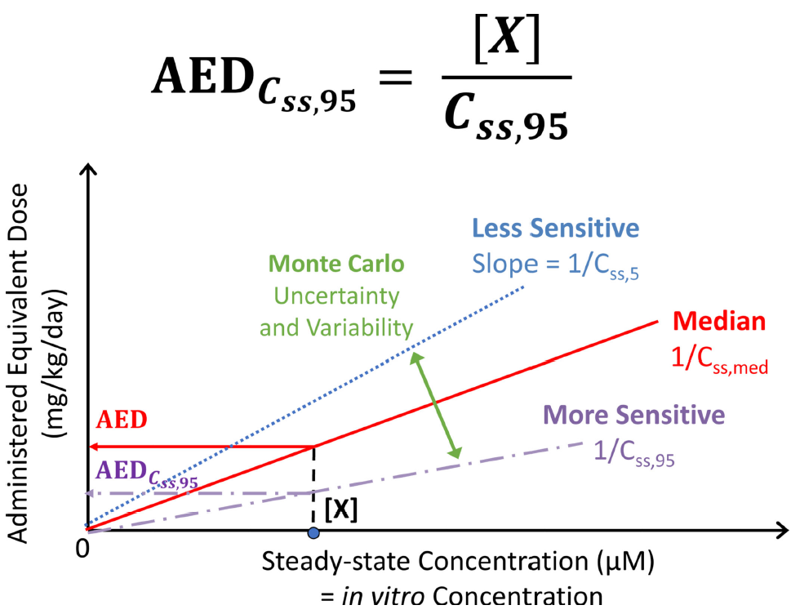
IVIVE Background
A new approach method (NAM) that uses in vitro data to predict in vivo effects of a chemical
Toxicokinetic IVIVE estimates the in vivo external dose (oral equivalent dose – OED) needed to produce an internal bioactive concentration comparable to that seen in vitro
If chemical exposure data is available, then a bioactivity exposure ratio (BER) can be calculated to estimate potential health risk of the chemical
BER < 1: A chemical may pose a health risk and should be investigated further
Breen, M., Ring, C.L., Kreutz, A., Goldsmith, M.R. and Wambaugh, J.F. (2021). High-throughput PBTK models for in vitro to in vivo extrapolation. Expert opinion on drug metabolism & toxicology

Slide 5
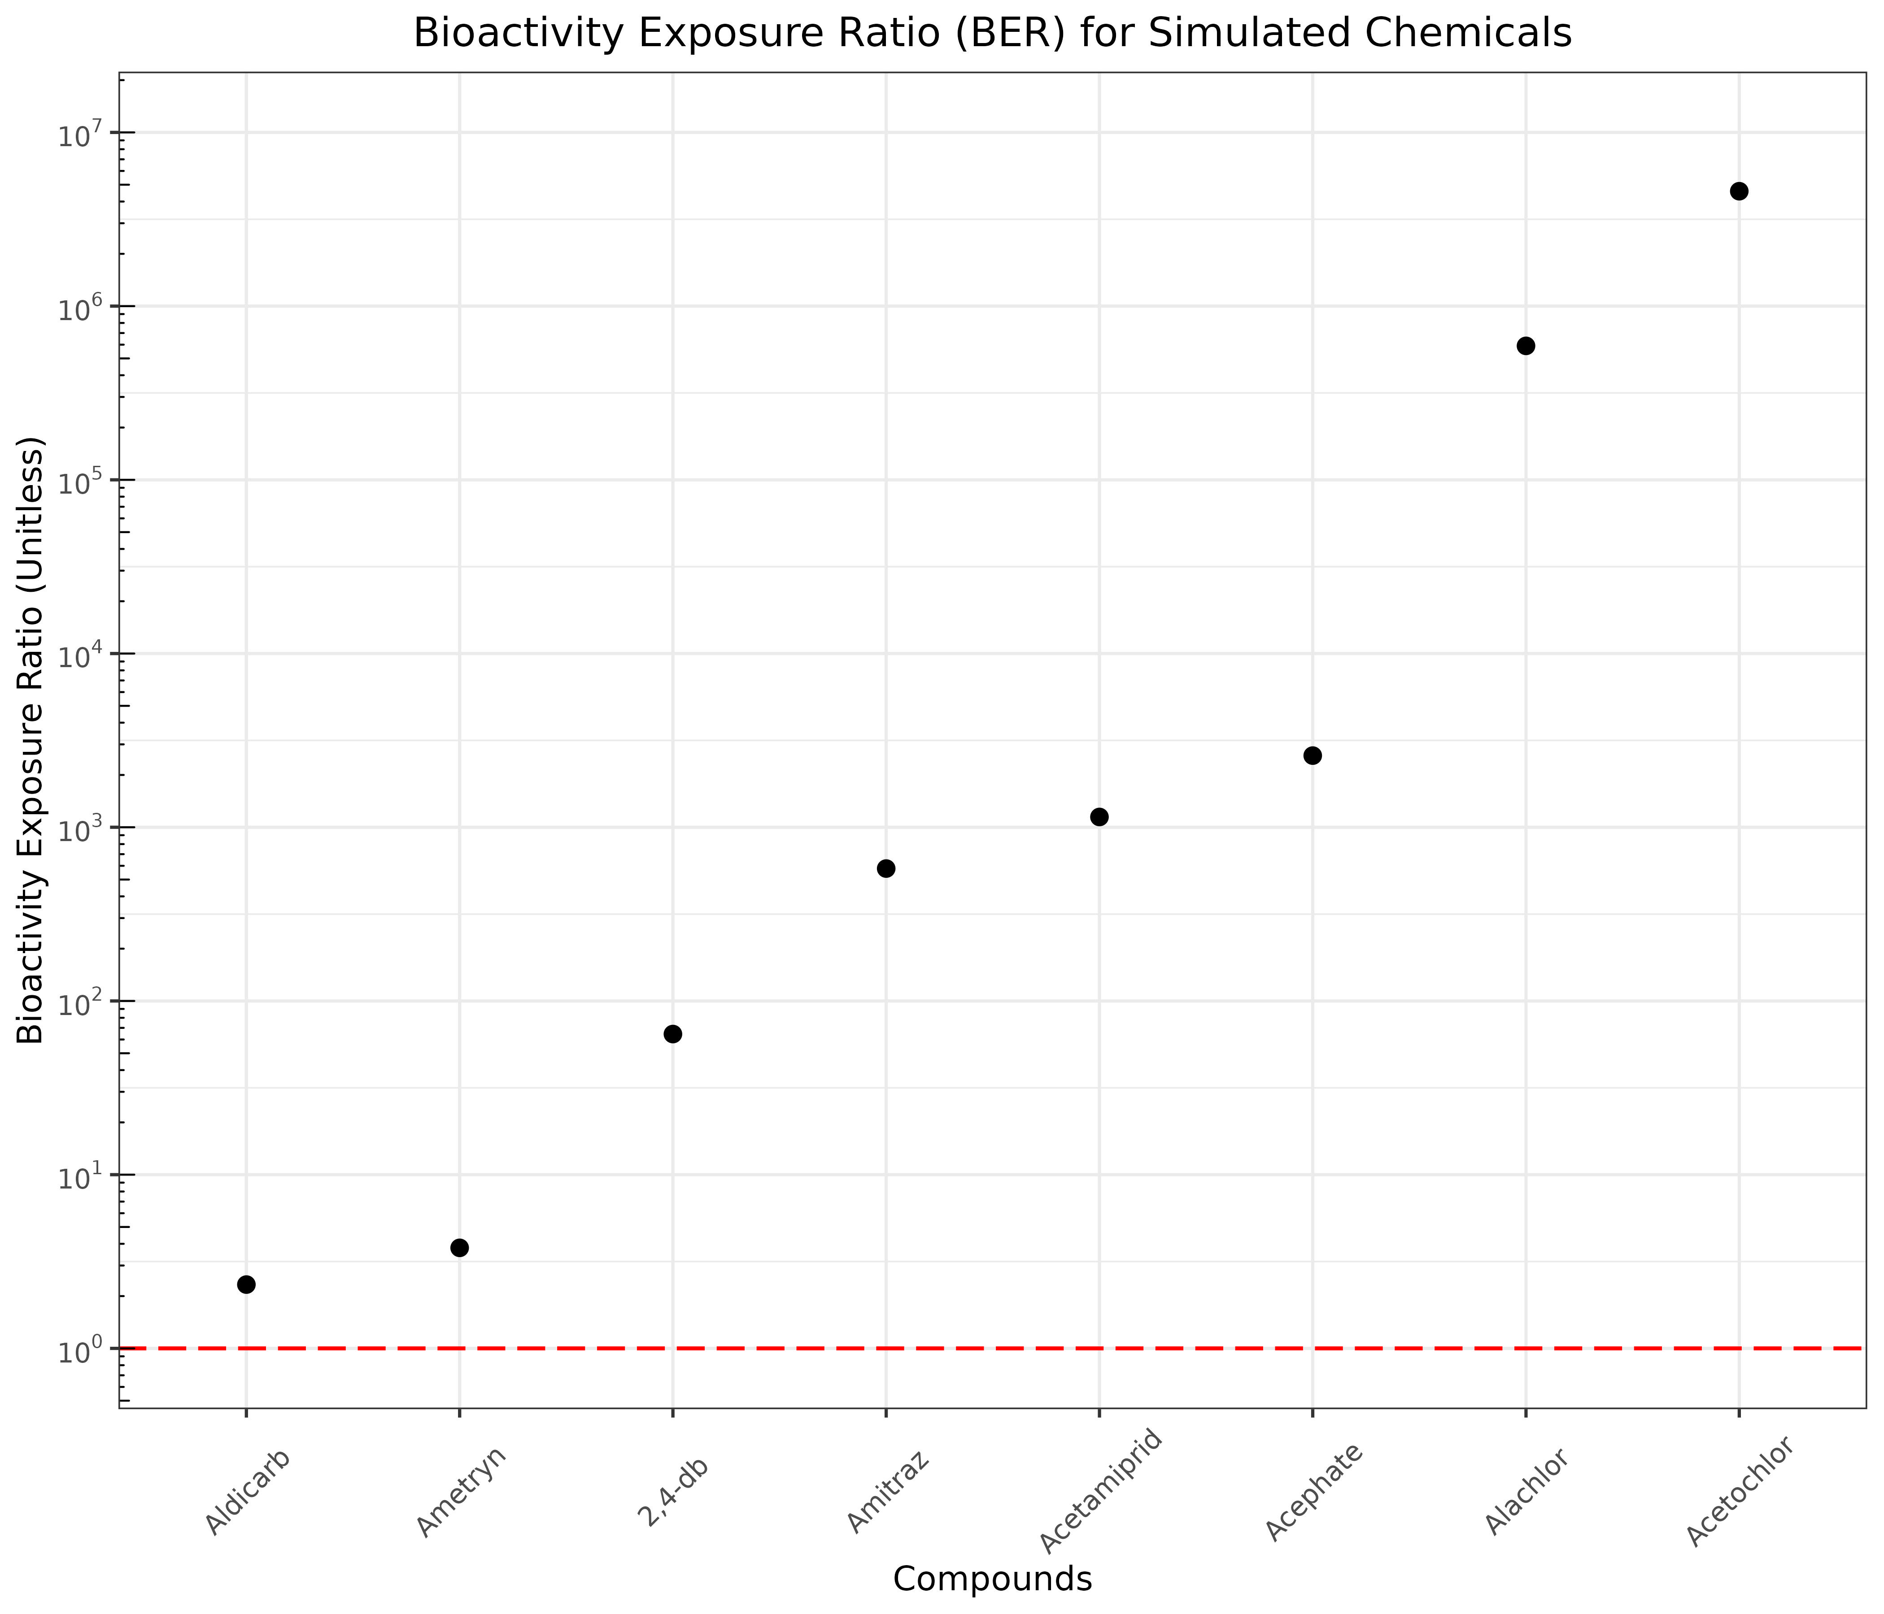
IVIVE Module Outputs
Plot and table of oral equivalent doses (OEDs)
Represents the in vivo external chemical dose needed to achieve the internal chemical concentration that causes bioactivity in vitro
Plot and table of the bioactivity exposure ratio (BER) for each compound
A measure of risk, comparing current exposure level with the OED
Prediction is only available if exposure data is provided by the user

Slide 6
IVIVE Module Inputs
Required:
Species and species preferences (if applicable)
Model selection
In silico parameter preference
IVIVE conditions and output preference
Chemicals to simulate
In vitro bioactivity data
Optional:
In vivo exposure data
Bioavailability settings
Output units, concentration type (plasma, blood), and tissue compartment
Monte Carlo sampling parameters
Model calculation preferences for hepatic clearance, fraction unbound, and partition coefficients

Slide 7
IVIVE Conditions for Selection
Assumption Selection | Metabolic Clearance |  | Bioactive Concentration In Vivo |  |  | Bioactive Concentration In Vitro
 | Restrictive | Non-Restrictive* | Free Venous Plasma | Total Venous Plasma | Total Specified Tissue | Nominal | Free
NULL | X |  |  |  | X | X
Honda1 | X |  | X |  |  |  | X
Honda2 | X |  | X |  |  | X
Honda3 | X |  |  | X |  | X
Honda4 |  | X |  |  | X | X
*Protein binding NOT taken into account in liver clearance

Slide 8
In Vitro Bioactivity Data (Required for IVIVE)
Needed to compute an oral equivalent dose (OED)
Data could be retrieved from:
EPA’s CompTox Dashboard (https://comptox.epa.gov/dashboard)
NTP’s ICE platform (https://ice.ntp.niehs.nih.gov/)
Internal databases
Literature publications

Slide 9
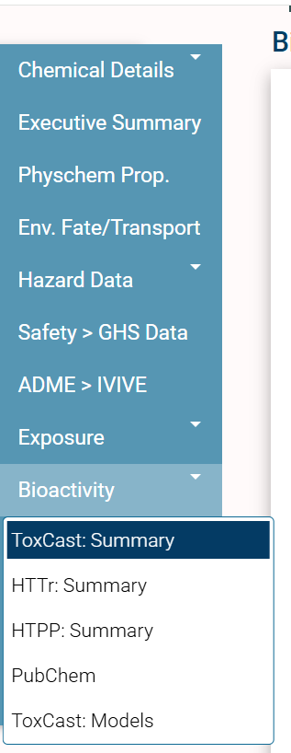
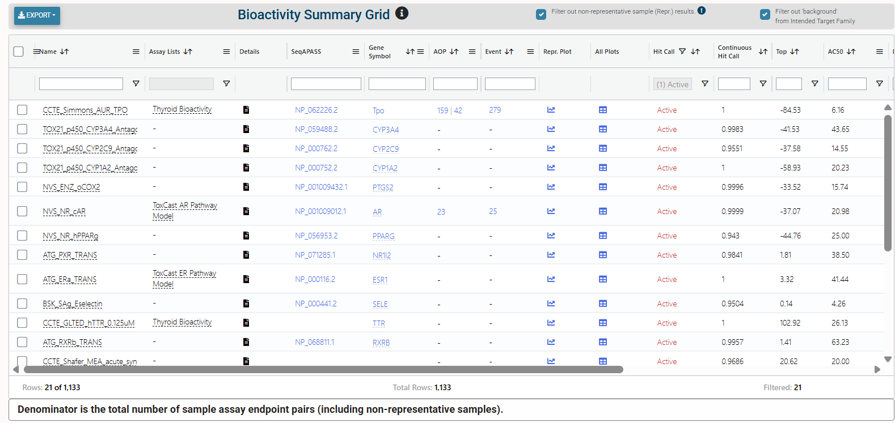
Bioactivity Data: EPA’s CompTox Dashboard

Slide 10
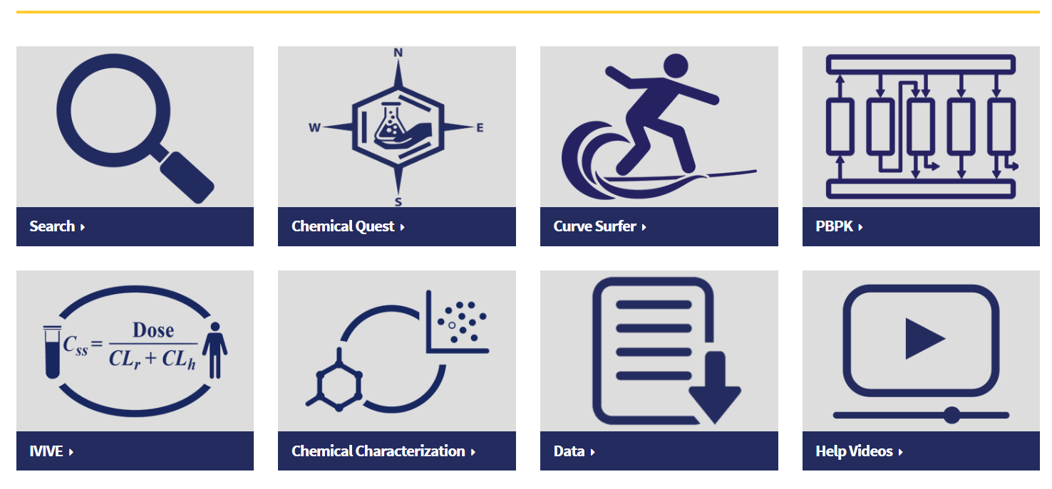
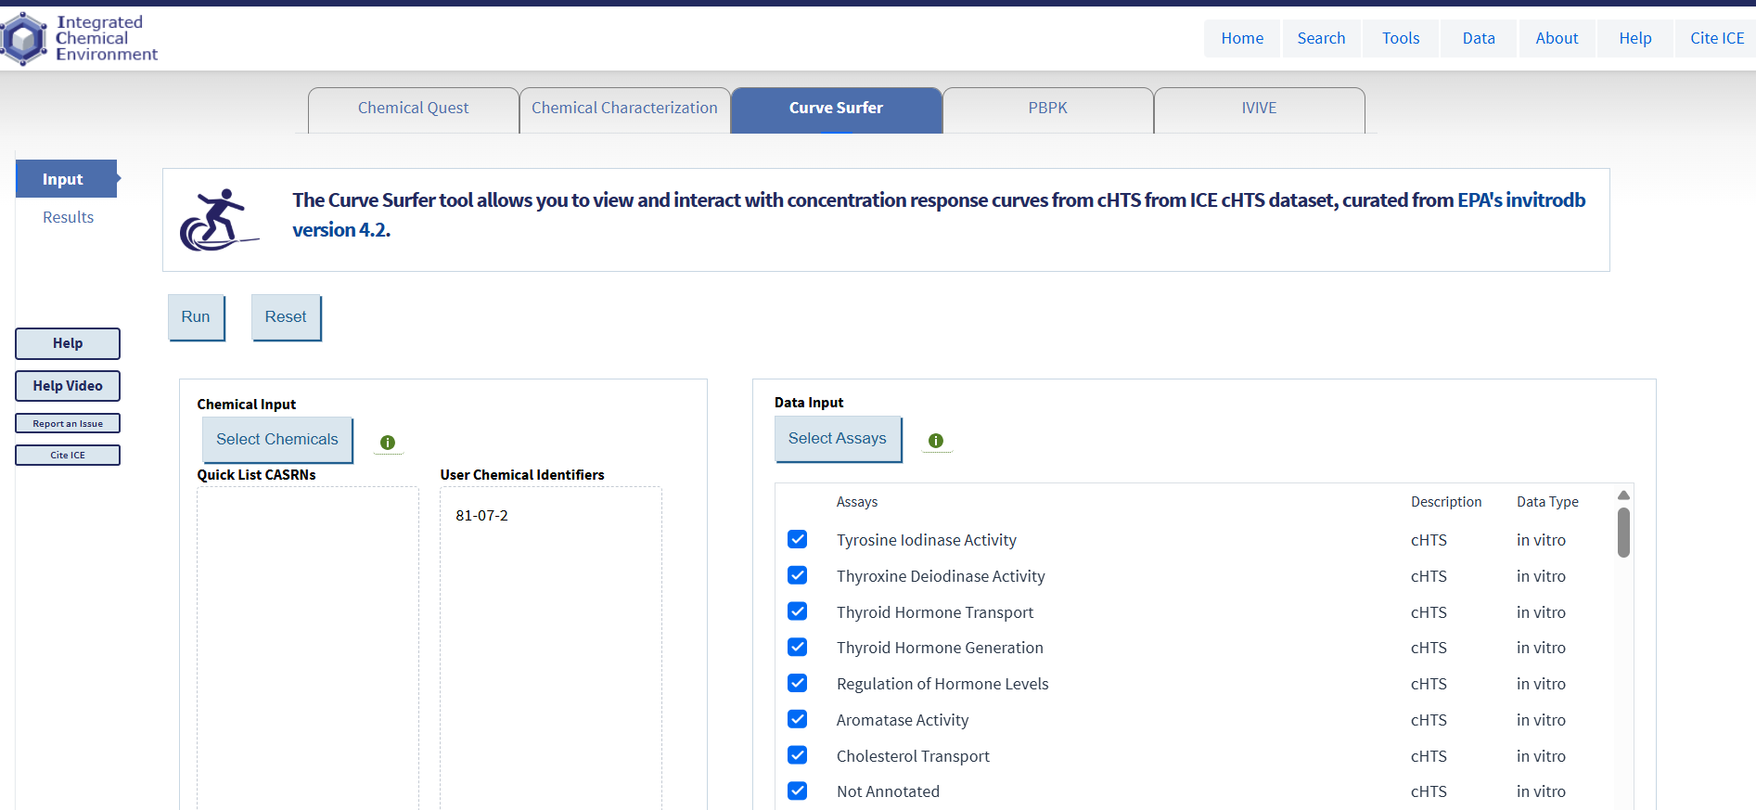
Bioactivity Data: NTP’s ICE Platform
Select the assays you want to consider for the bioactivity
Enter chemical identifiers for the chemical(s) you want to find bioactivity for

Slide 11
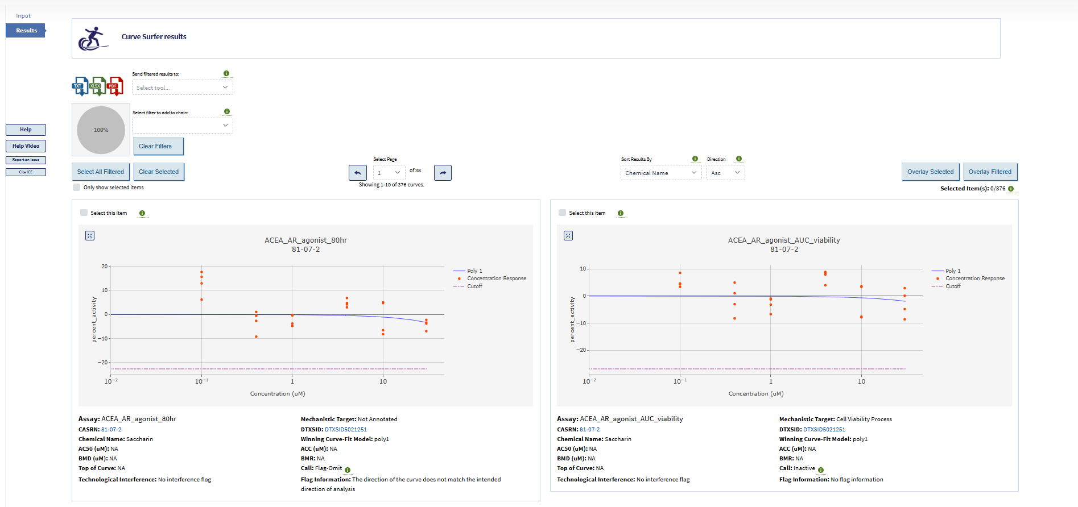
Bioactivity Data: NTP’s ICE Platform

Slide 12
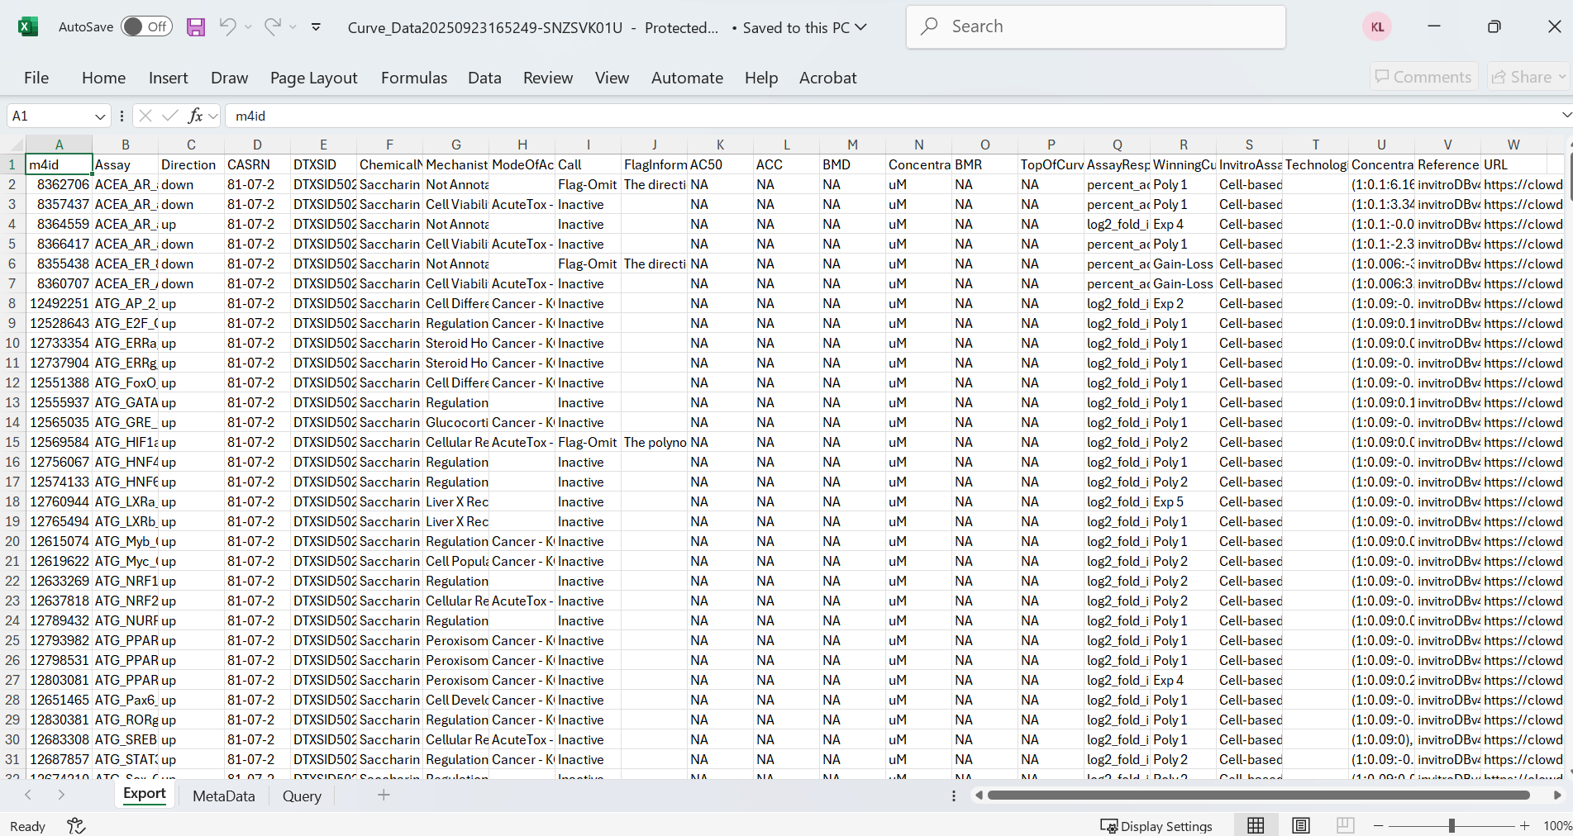
Bioactivity Data: NTP’s ICE Platform
Determine the bioactive concentration for each compound by exploring only “active” calls and using your desired measure and calculation method (generally use the AC50 or ACC)

Slide 13
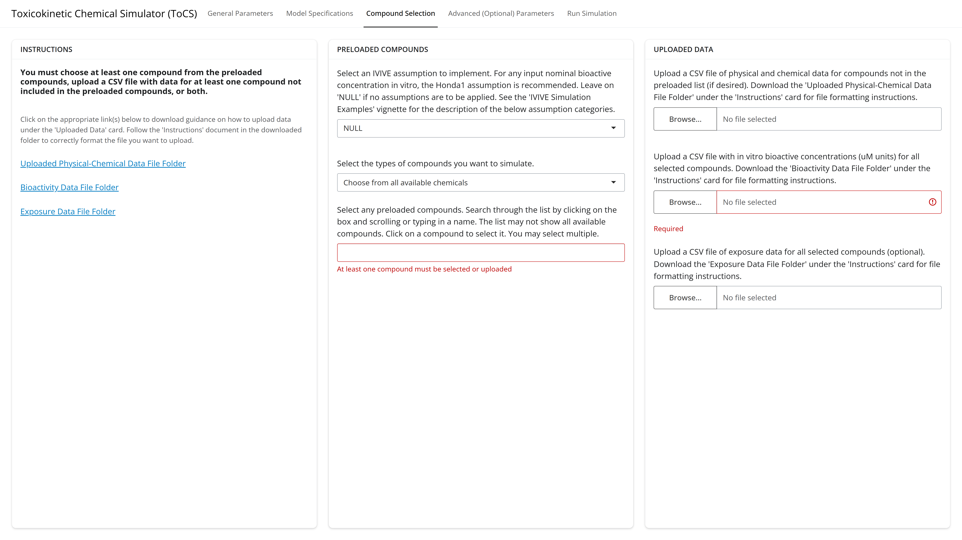
Uploading a CSV File of Bioactivity Data
Downloadable folder with instructions for uploading bioactivity data CSV
Click ‘Browse’ to find and upload the CSV file of bioactivity data

Slide 14
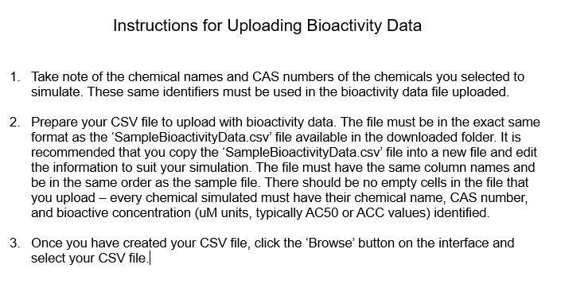
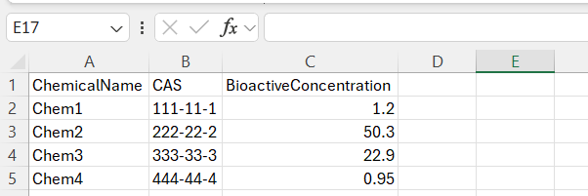
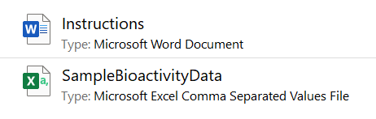
Uploading a CSV File of Bioactivity Data

Slide 15
Uploading a CSV File of Bioactivity Data
Copy and paste the SampleBioactivityData.csv file into the location of choice and rename as desired.
Leave the column headers as is. Delete the entries in all other rows.
Fill in each chemical name that you will be simulating and their corresponding CAS numbers. These identifiers MUST match the names and CAS numbers from the preloaded list or uploaded chemical data.
Fill in the in vitro bioactive concentration (in uM units) for each compound. Only one bioactive concentration per compound is permitted.
Save the CSV file.
Upload CSV file to ToCS interface.

Slide 16
In Vivo Exposure Data (Optional)
Needed to compute the bioactivity exposure ratio (BER)
Data could be retrieved from:
EPA’s CompTox Dashboard (https://comptox.epa.gov/dashboard)
NTP’s ICE platform (https://ice.ntp.niehs.nih.gov/)
FDA’s Cumulative Estimated Daily Intake (CEDI) public database (https://www.hfpappexternal.fda.gov/scripts/fdcc/index.cfm?set=CEDI)

Slide 17
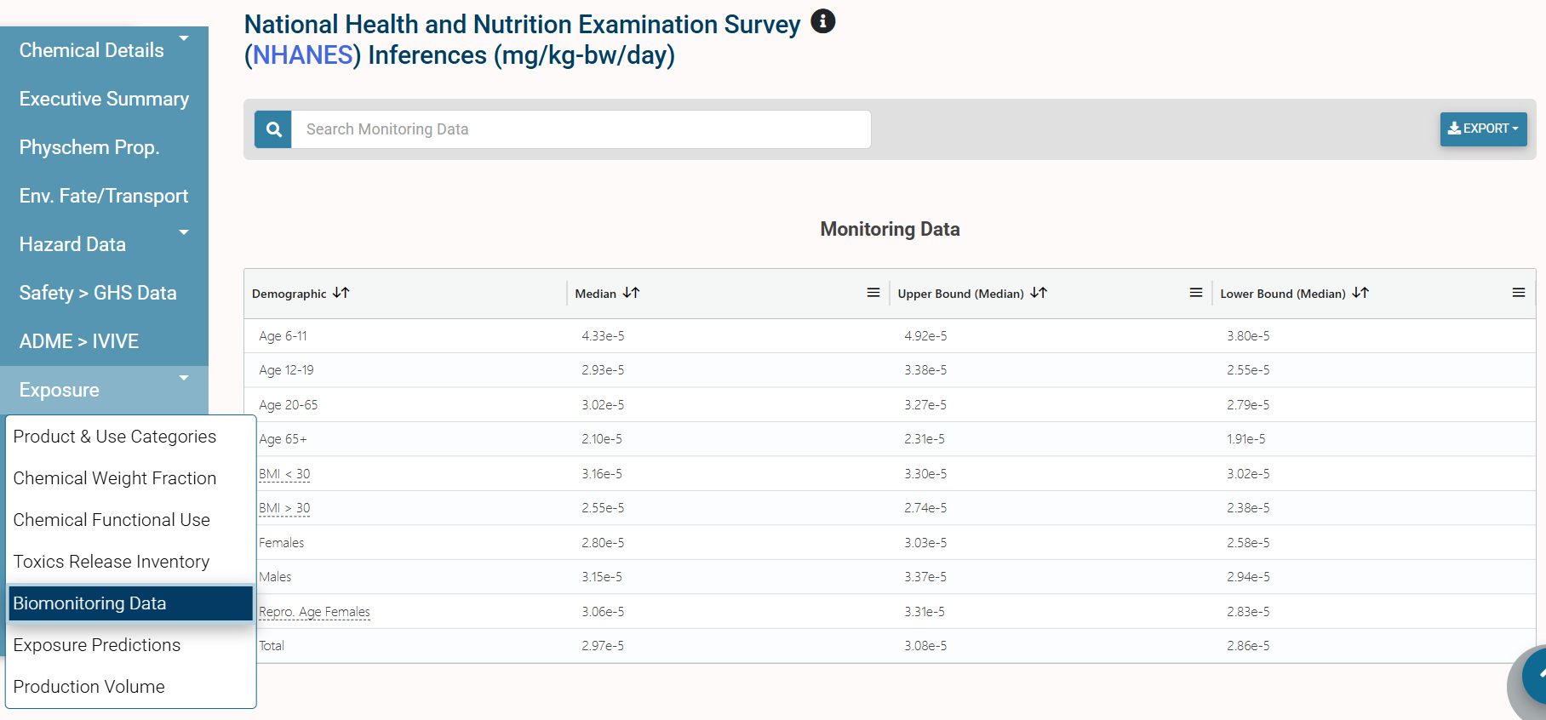
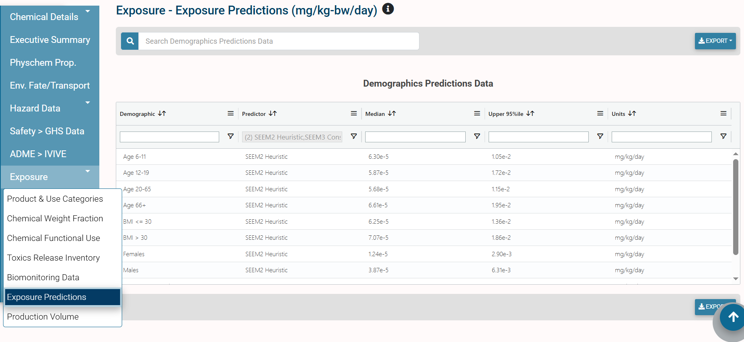
Exposure Data: EPA’s CompTox Dashboard
National Health and
Nutrition Examination Survey
(NHANES) Data
In Silico Predicted Data (EPA Models)

Slide 18
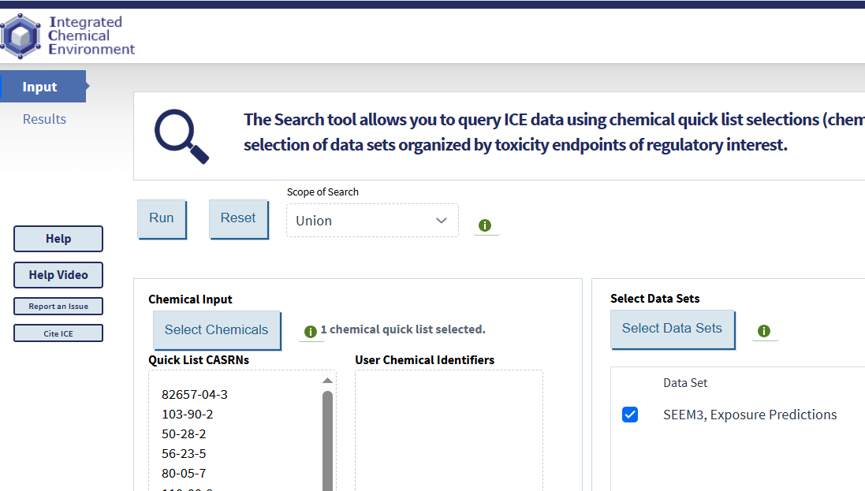
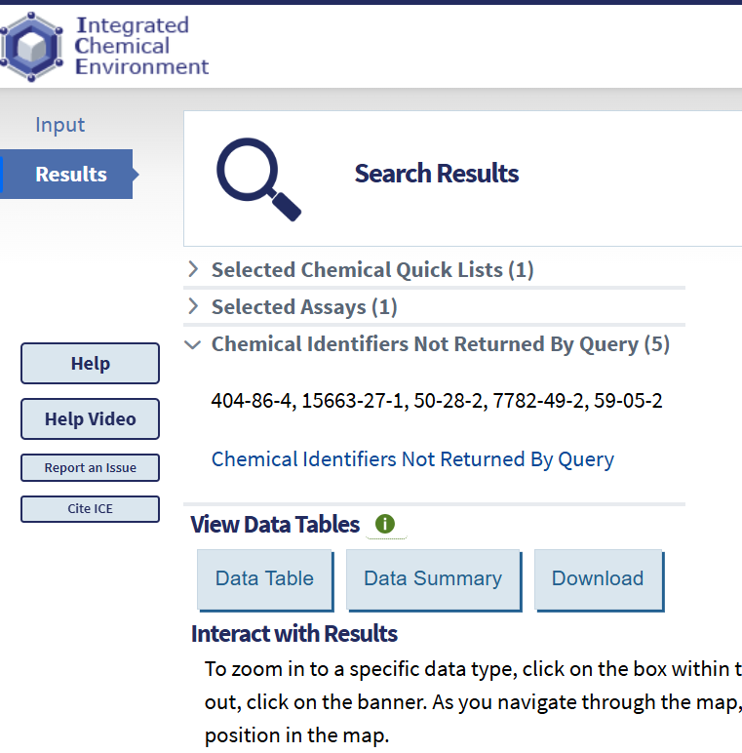
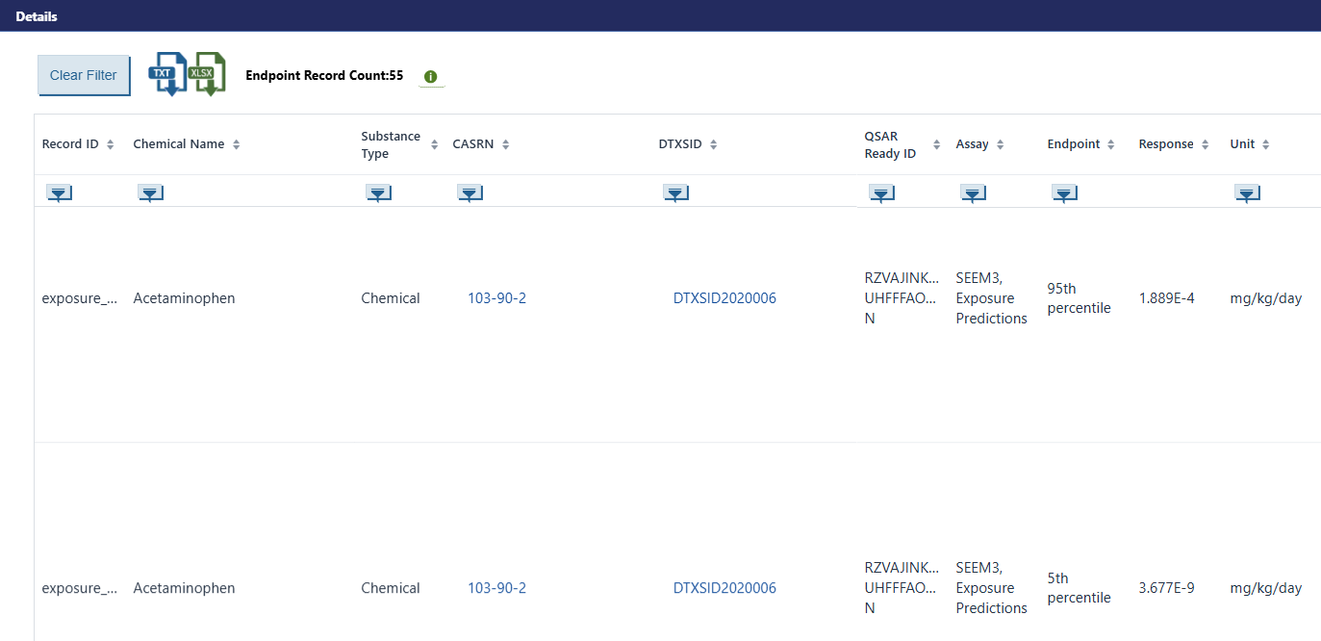
Exposure Data: NTP’s ICE Platform

Slide 19
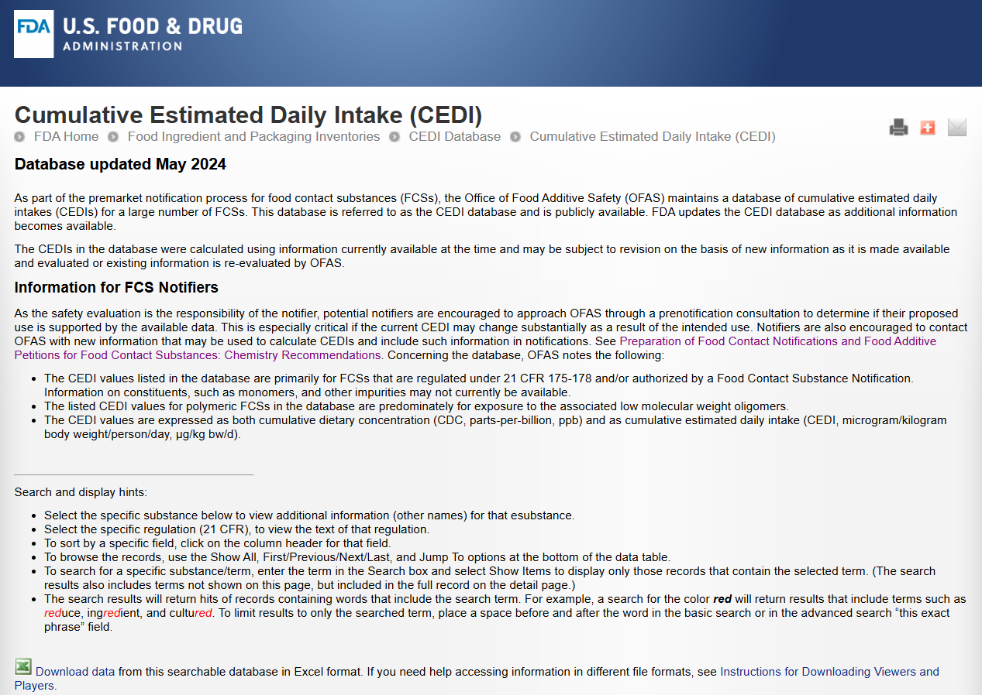
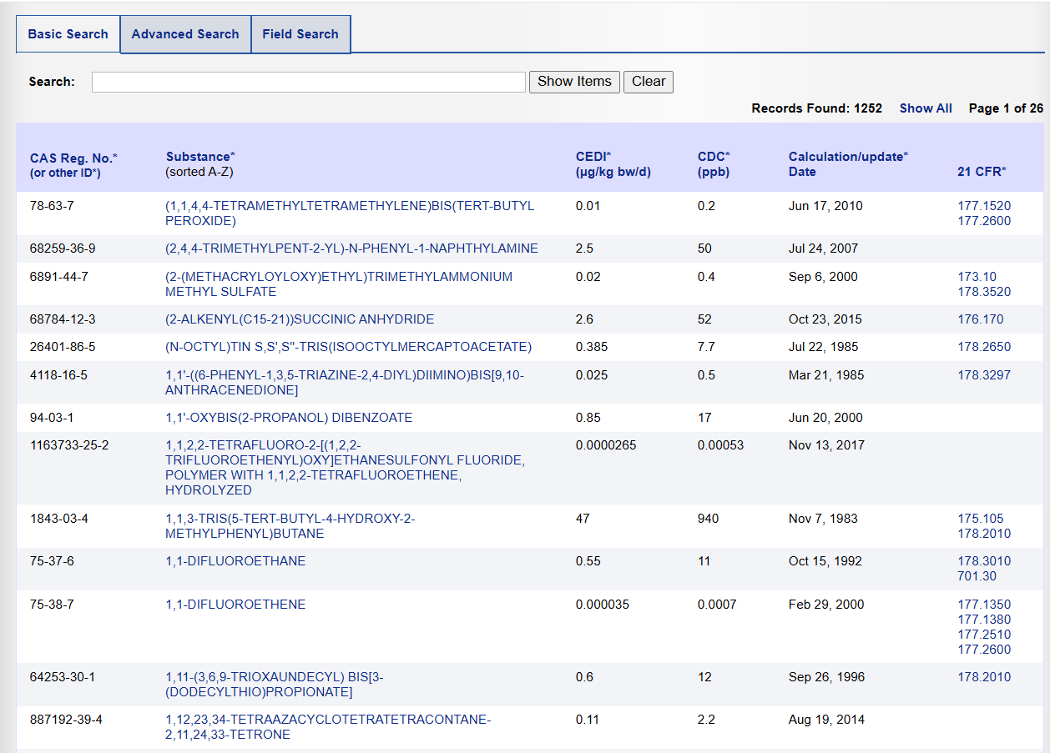
Exposure Data: FDA CEDI Database
Be careful of units! ToCS needs mg/kg-BW/day.

Slide 20
Uploading a CSV File of Exposure Data
Downloadable folder with instructions for uploading exposure data CSV
Click ‘Browse’ to find and upload the CSV file of exposure data

Slide 21
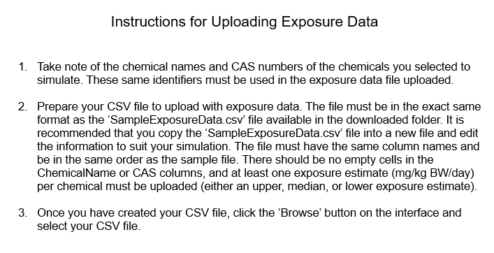
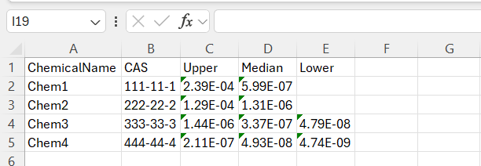
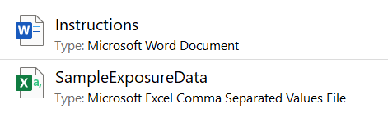
Uploading a CSV File of Exposure Data

Slide 22
Uploading a CSV File of Exposure Data
Copy and paste the SampleExposureData.csv file into the location of choice and rename as desired.
Leave the column headers as is. Delete the entries in all other rows.
Fill in each chemical name that you will be simulating and their corresponding CAS numbers. These identifiers MUST match the names and CAS numbers from the preloaded list or uploaded chemical data.
Fill in the upper, median, and lower exposure estimates (mg/kg-BW/day) as desired. There must be AT LEAST one exposure point per compound.
Save the CSV file.
Upload CSV file to ToCS interface.

Slide 23
Example 1 Scenario
Obtain the bioactivity exposure ratios of six flavoring agents using the pbtk model
Do not use the available in silico parameters
Return the 5th OED quantile (95th steady state concentration quantile)
Use the Honda1 IVIVE assumption
Chemical Name | CAS | Bioactive Concentration* | Exposure Upper^ | Exposure Median^ | Exposure Lower^
Butylparaben | 94-26-8 | 14.06 | 1.51E-6 | 1.28E-6 | 1.09E-6
Acetophenone | 98-86-2 | 15.90 | 0.263 | 6.07E-5
Methyl salicylate | 119-36-8 | 31.40 | 0.184 | 2.17E-4
Resorcinol | 108-46-3 | 6.626 | 5.85E-2 | 1.91E-5
o-Cresol | 95-48-7 | 47.30 | 0.105 | 3.22E-4
p-Cresol | 106-44-5 | 38.88 | 1.52 | 1.53E-3
* = uM
^ = mg/kw-BW/day
Notes:
0,2,4,6,8,10,12,14,16,18,20,22,24,26,28,1,1,1,1,1,1,1,1,1,1,1,1,1,1,1

Slide 24
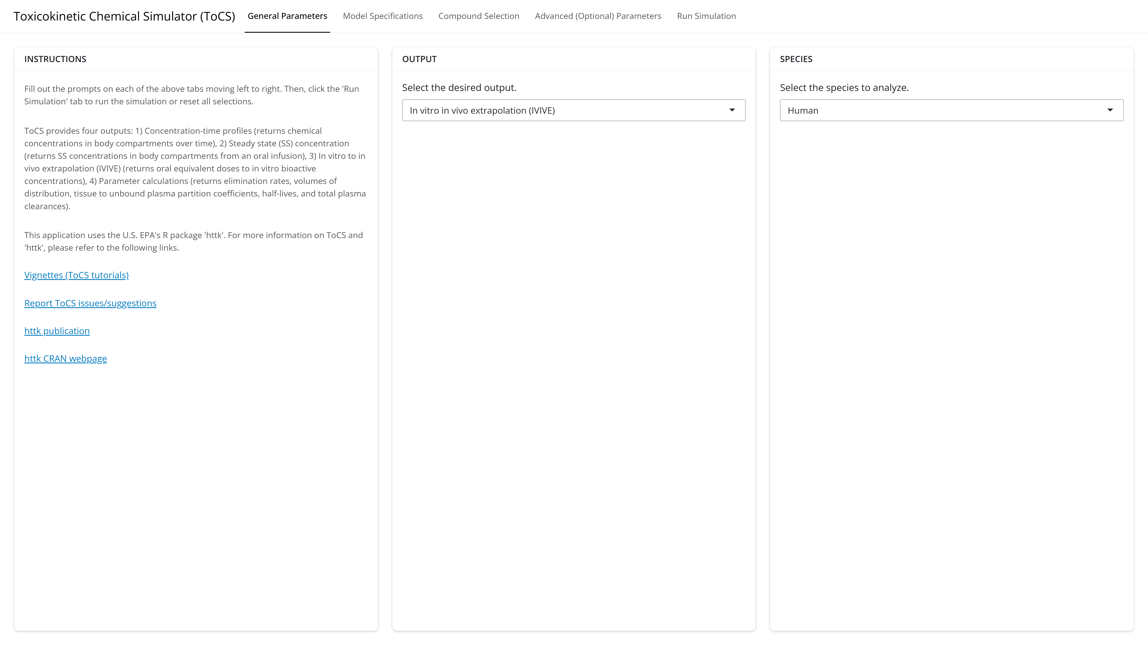
Example 1: General Parameters Tab
Notes:
0,2,4,6,8,10,12,14,16,18,20,22,24,26,28,1,1,1,1,1,1,1,1,1,1,1,1,1,1,1

Slide 25
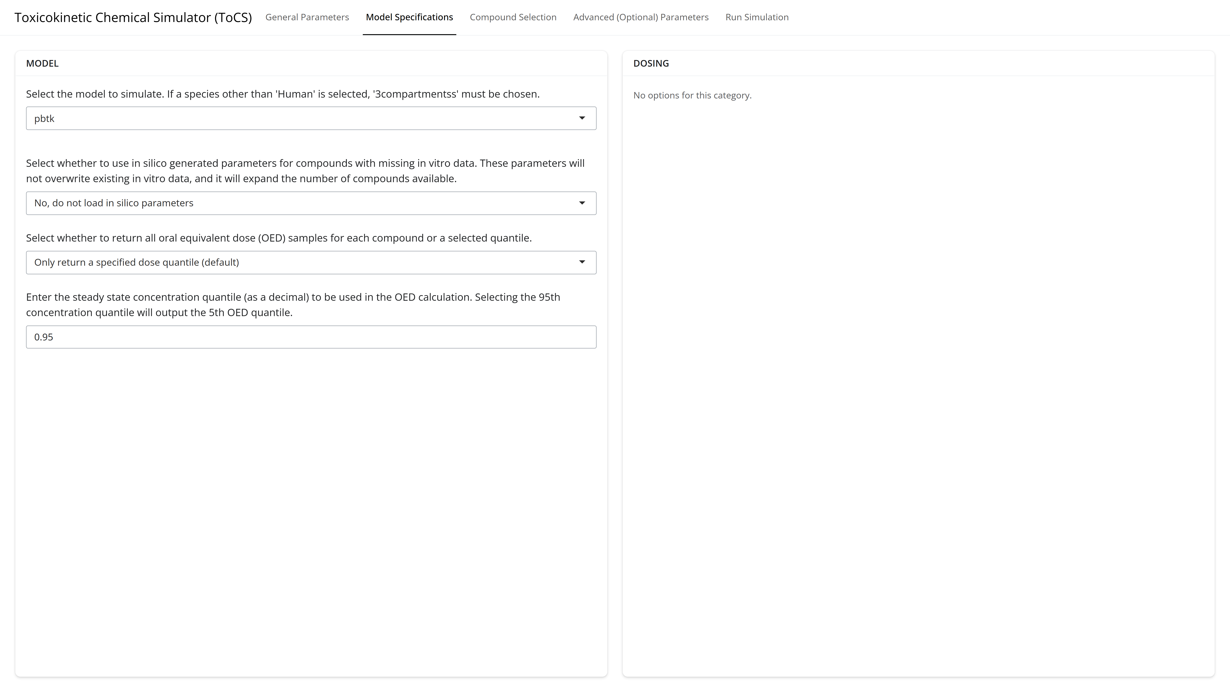
Example 1: Model Specifications Tab
Notes:
0,2,4,6,8,10,12,14,16,18,20,22,24,26,28,1,1,1,1,1,1,1,1,1,1,1,1,1,1,1

Slide 26
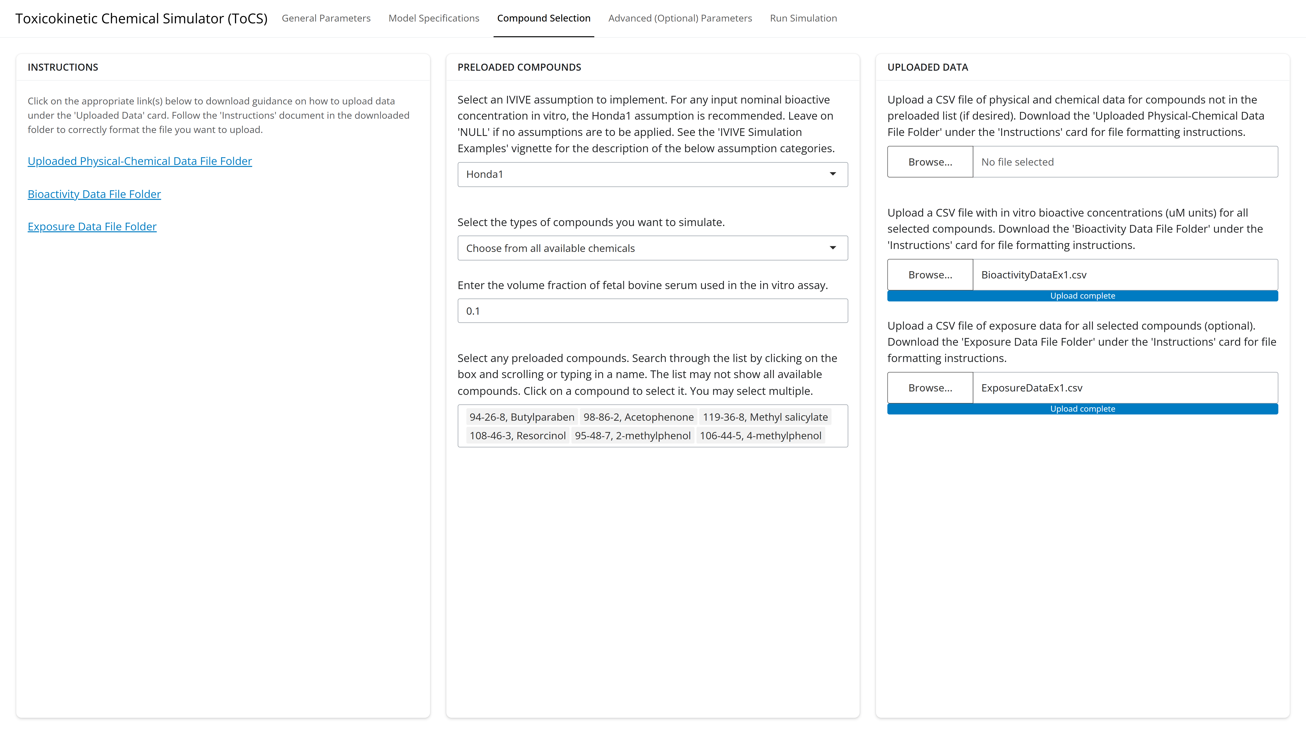
Example 1: Compound Selection Tab
Notes:
0,2,4,6,8,10,12,14,16,18,20,22,24,26,28,1,1,1,1,1,1,1,1,1,1,1,1,1,1,1

Slide 27
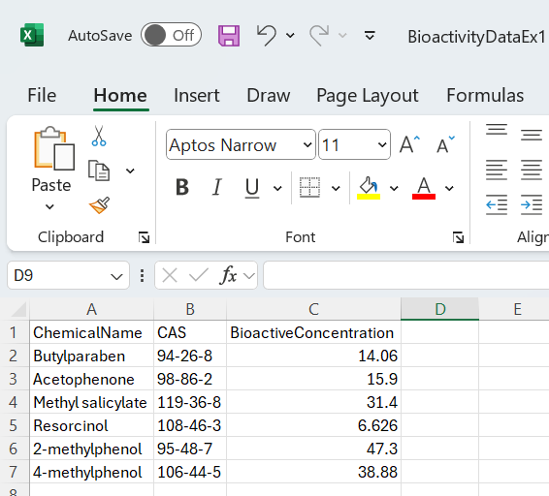
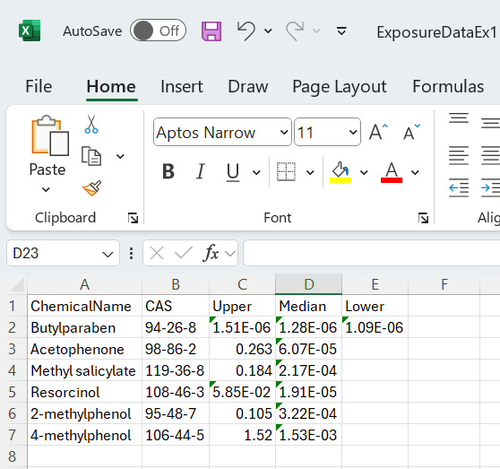
Example 1: Bioactivity and Exposure Data Files
Notes:
0,2,4,6,8,10,12,14,16,18,20,22,24,26,28,1,1,1,1,1,1,1,1,1,1,1,1,1,1,1

Slide 28
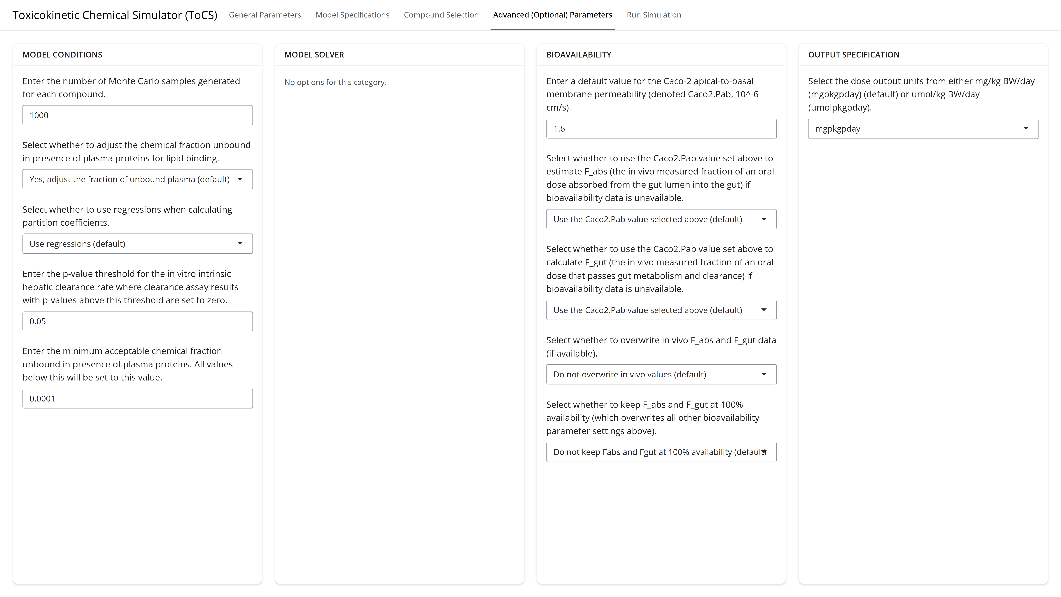
Example 1: Advanced Parameters Tab
Notes:
0,2,4,6,8,10,12,14,16,18,20,22,24,26,28,1,1,1,1,1,1,1,1,1,1,1,1,1,1,1

Slide 29
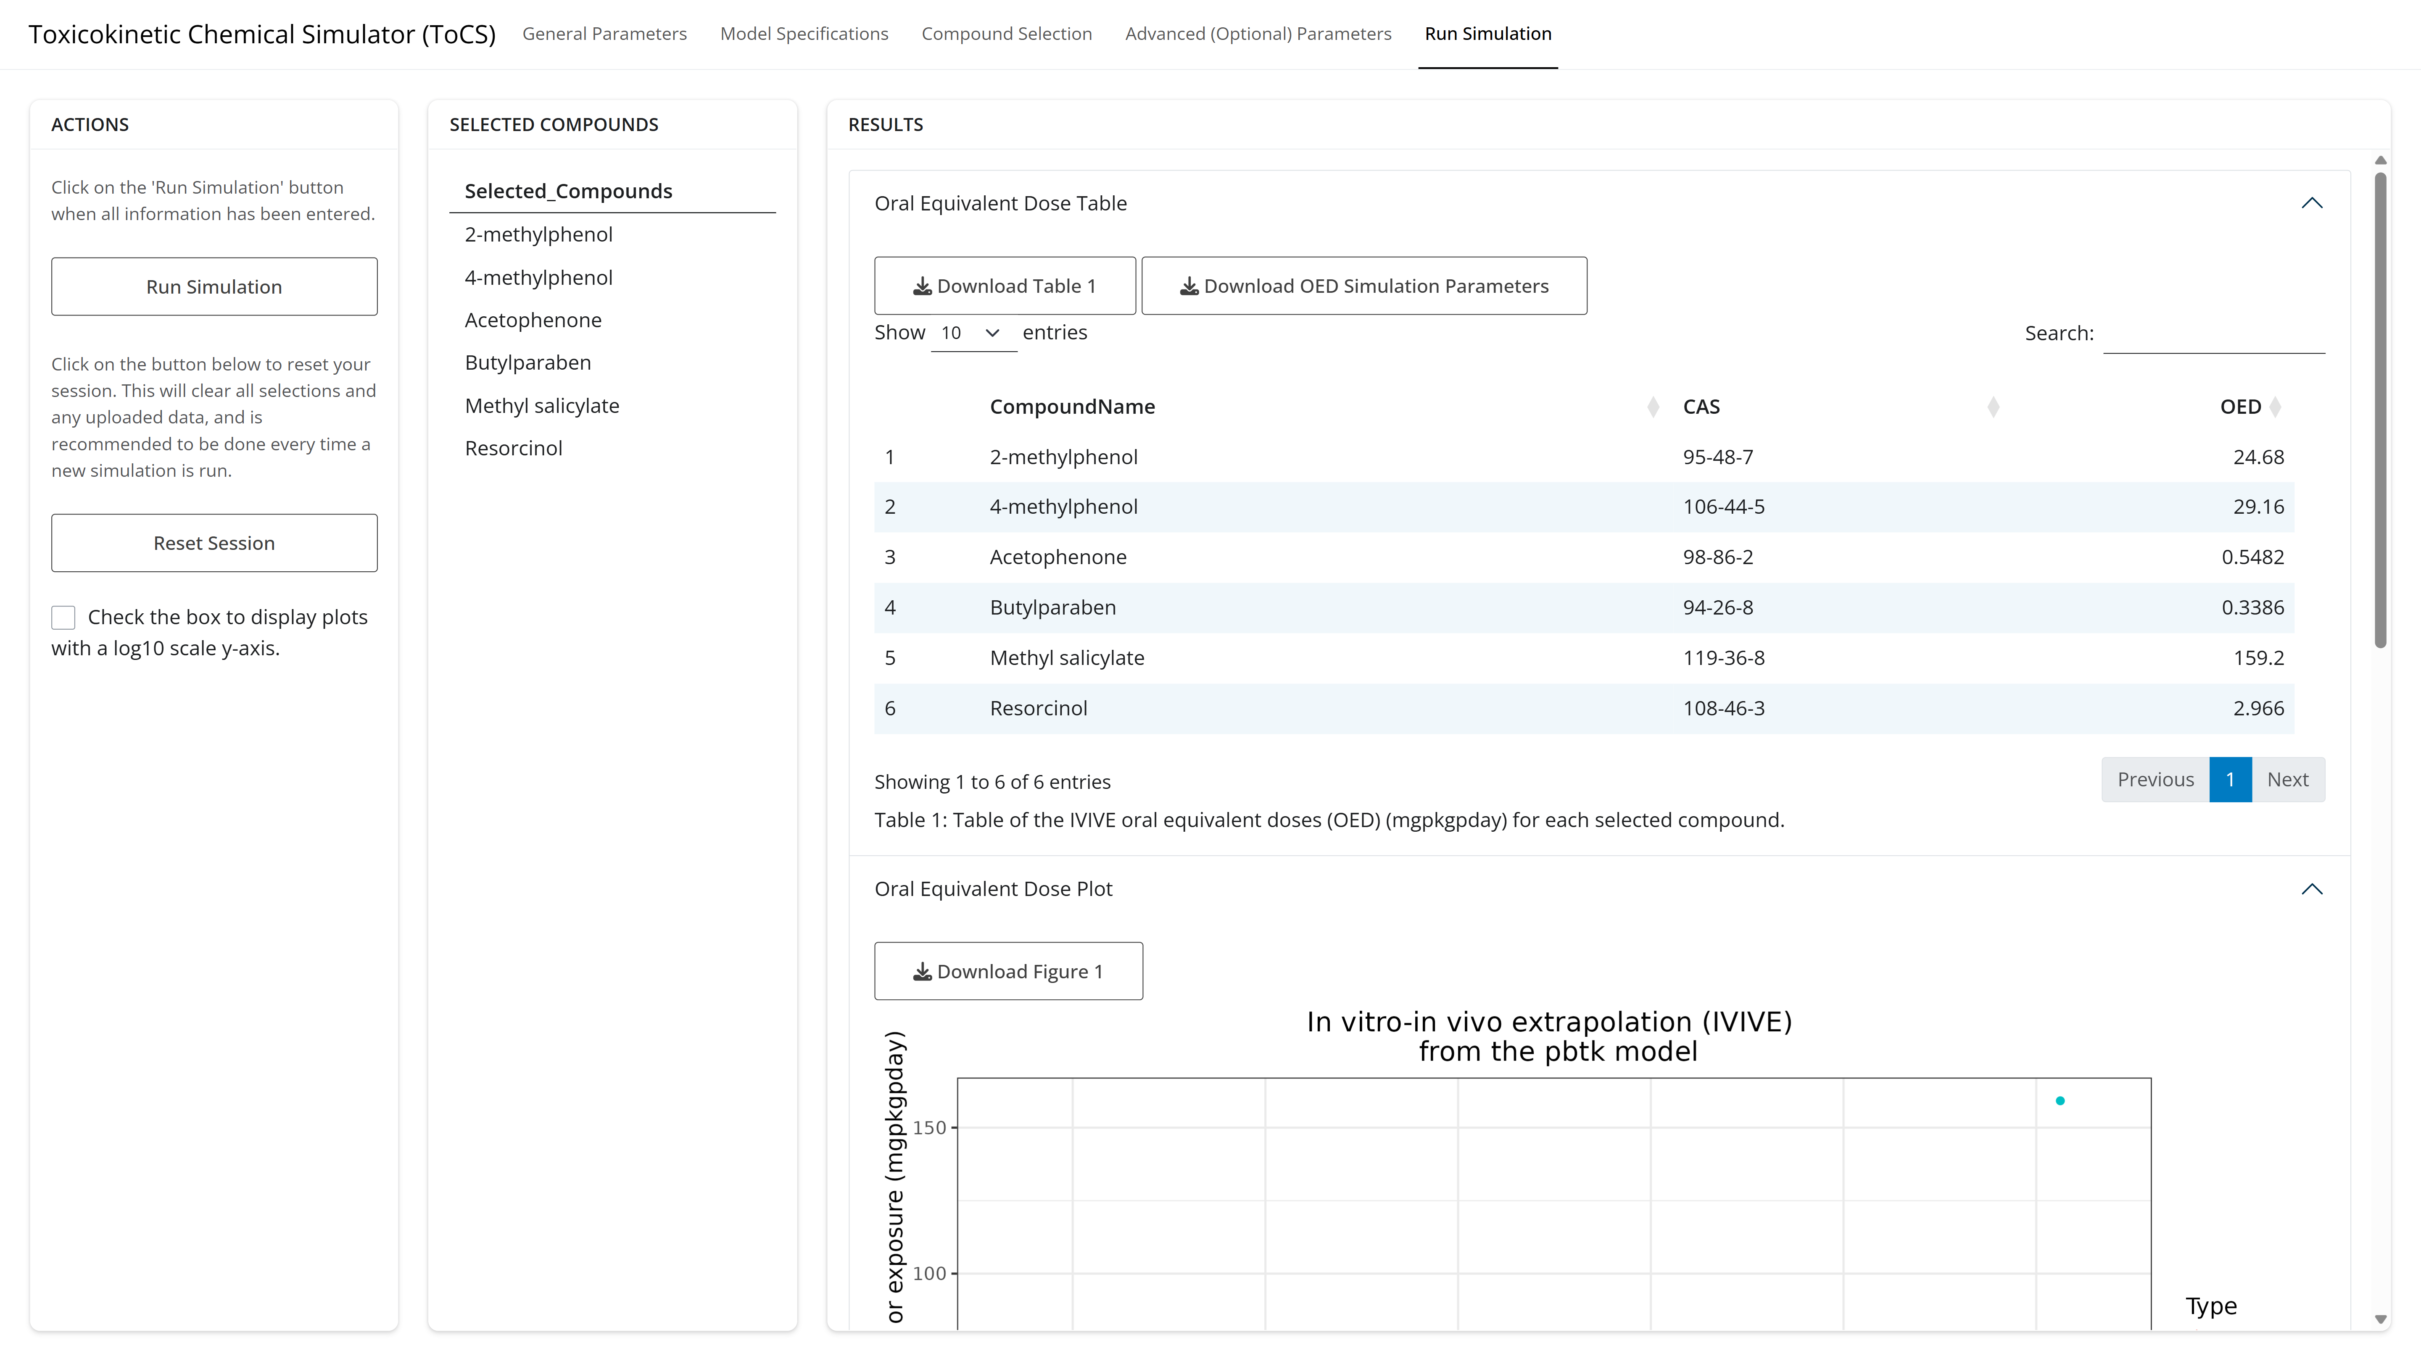
Example 1: Run Simulation Tab
Notes:
0,2,4,6,8,10,12,14,16,18,20,22,24,26,28,1,1,1,1,1,1,1,1,1,1,1,1,1,1,1

Slide 30
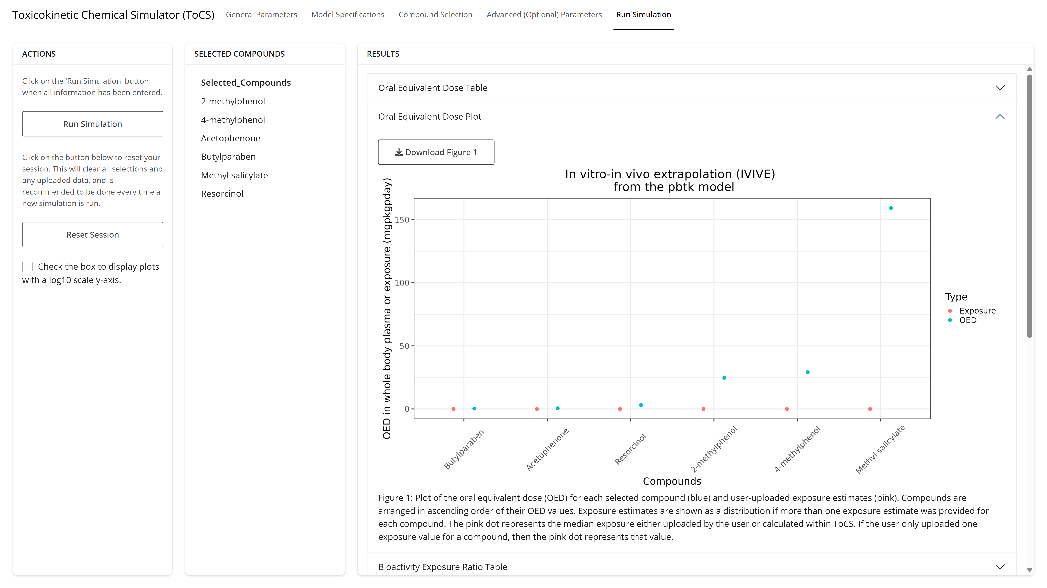
Example 1: Run Simulation Tab
Notes:
0,2,4,6,8,10,12,14,16,18,20,22,24,26,28,1,1,1,1,1,1,1,1,1,1,1,1,1,1,1

Slide 31
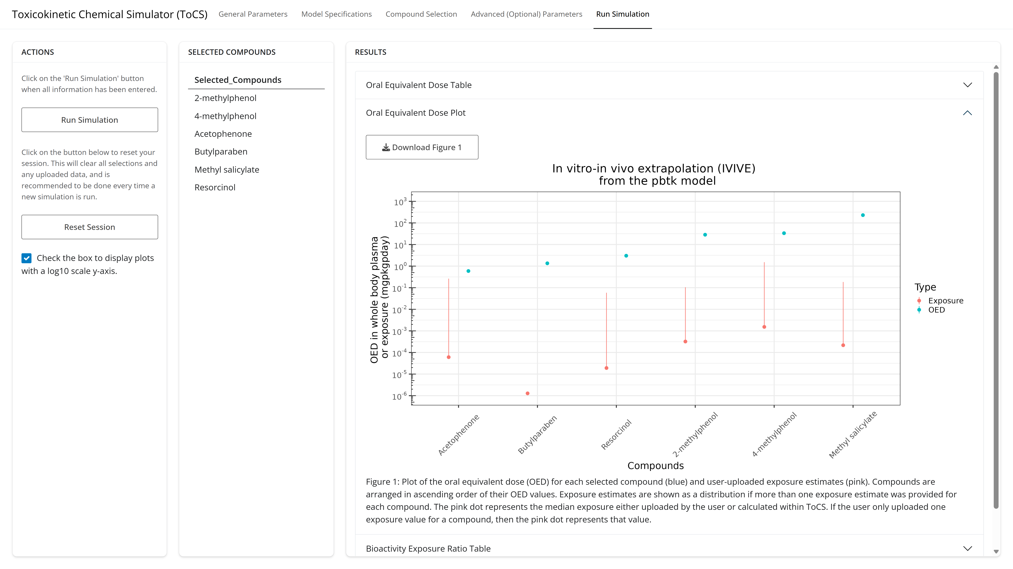
Example 1: Run Simulation Tab
Notes:
0,2,4,6,8,10,12,14,16,18,20,22,24,26,28,1,1,1,1,1,1,1,1,1,1,1,1,1,1,1

Slide 32
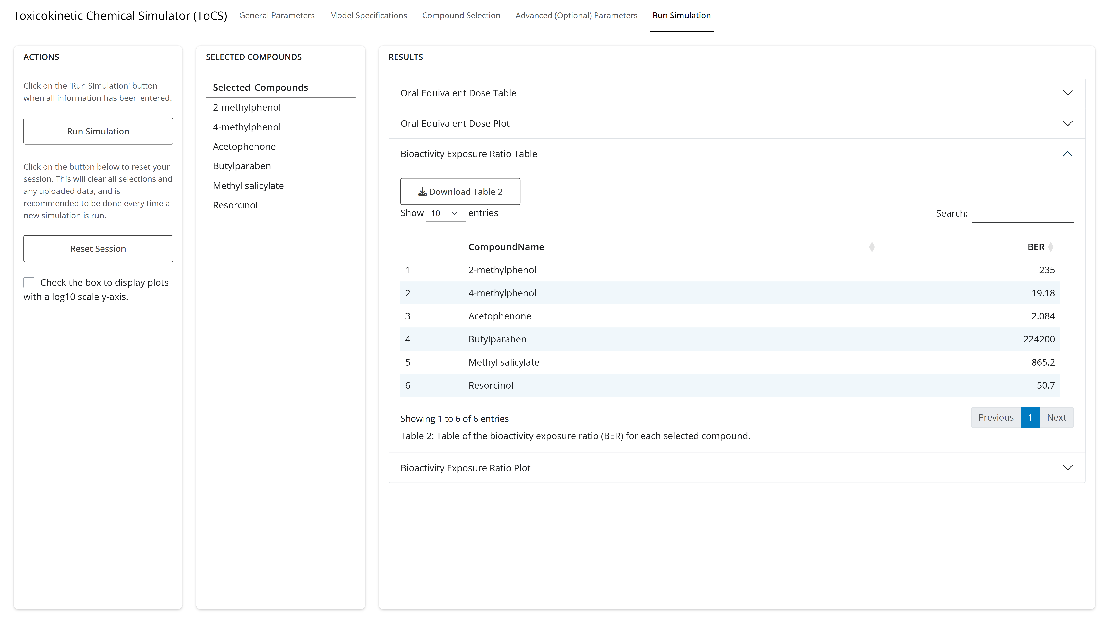
Example 1: Run Simulation Tab
Notes:
0,2,4,6,8,10,12,14,16,18,20,22,24,26,28,1,1,1,1,1,1,1,1,1,1,1,1,1,1,1

Slide 33
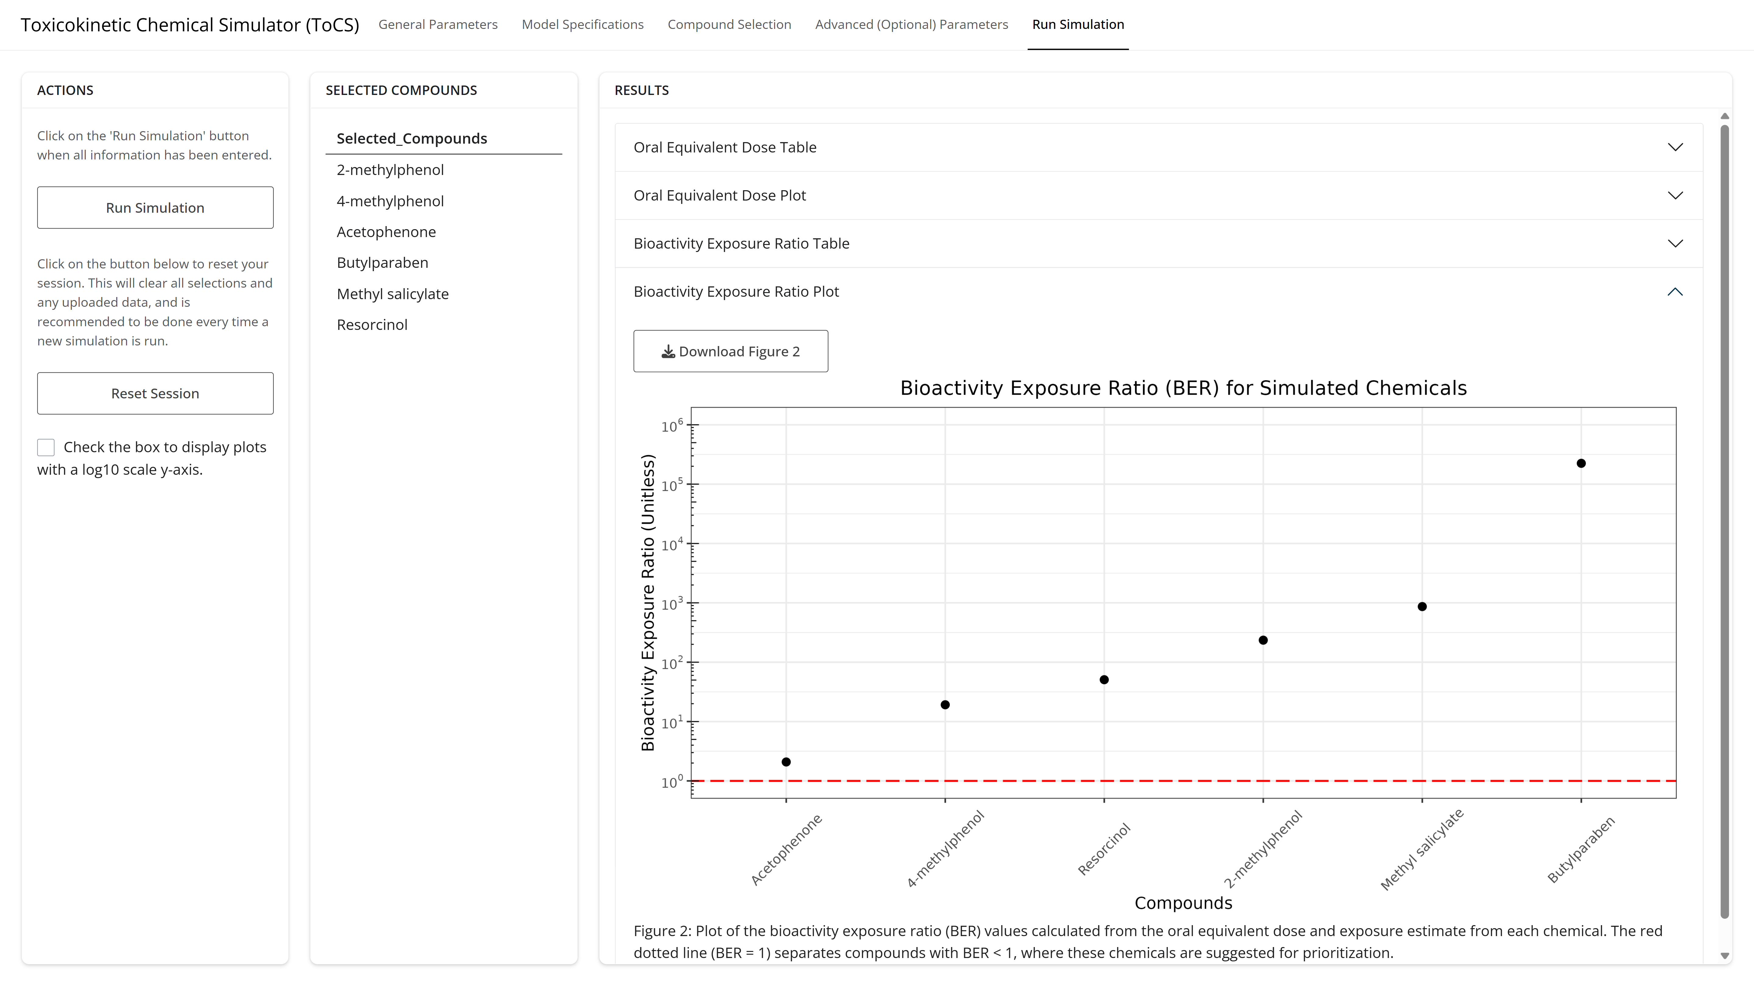
Example 1: Run Simulation Tab
Notes:
0,2,4,6,8,10,12,14,16,18,20,22,24,26,28,1,1,1,1,1,1,1,1,1,1,1,1,1,1,1

Slide 34
Example 2 Scenario
Obtain the oral equivalent doses (OEDs) of four direct food additives using the pbtk model
Do not use the available in silico parameters
Run 500 Monte Carlo steady state samples
Return the all OED samples
Use the Honda1 IVIVE assumption
Chemical Name | CAS | Bioactive Concentration* | Exposure Upper^ | Exposure Median^ | Exposure Lower^
Saccharin | 81-07-2 | 4.324E-3 | 1.24 | 2.02E-7
Theobromine | 83-67-0 | 5.316 | 1.73E-2 | 4.19E-6
Benzophenone | 119-61-9 | 4.425 | 0.236 | 3.09E-4
Eugenol | 97-53-0 | 16.01 | 0.353 | 9.20E-5
* = uM
^ = mg/kw-BW/day
Notes:
0,2,4,6,8,10,12,14,16,18,20,22,24,26,28,1,1,1,1,1,1,1,1,1,1,1,1,1,1,1

Slide 35
Example 2: General Parameters Tab
Notes:
0,2,4,6,8,10,12,14,16,18,20,22,24,26,28,1,1,1,1,1,1,1,1,1,1,1,1,1,1,1

Slide 36
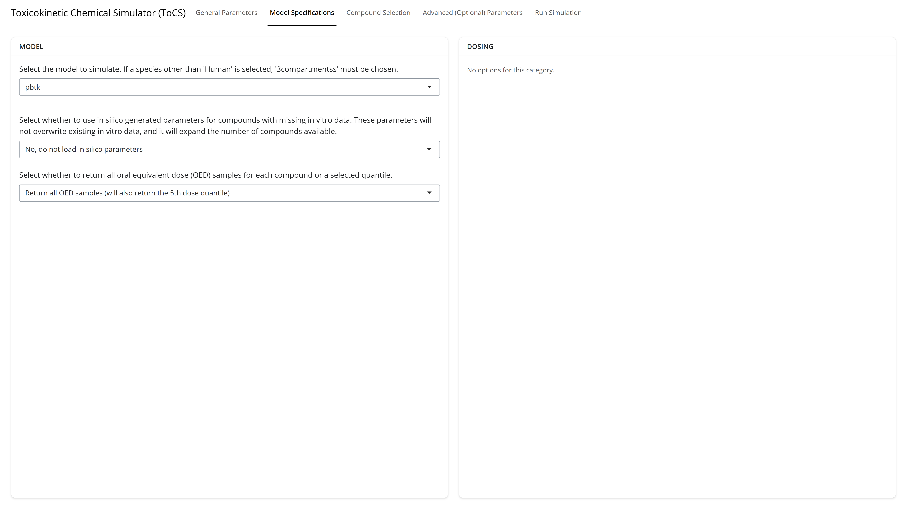
Example 2: Model Specifications Tab
Notes:
0,2,4,6,8,10,12,14,16,18,20,22,24,26,28,1,1,1,1,1,1,1,1,1,1,1,1,1,1,1

Slide 37
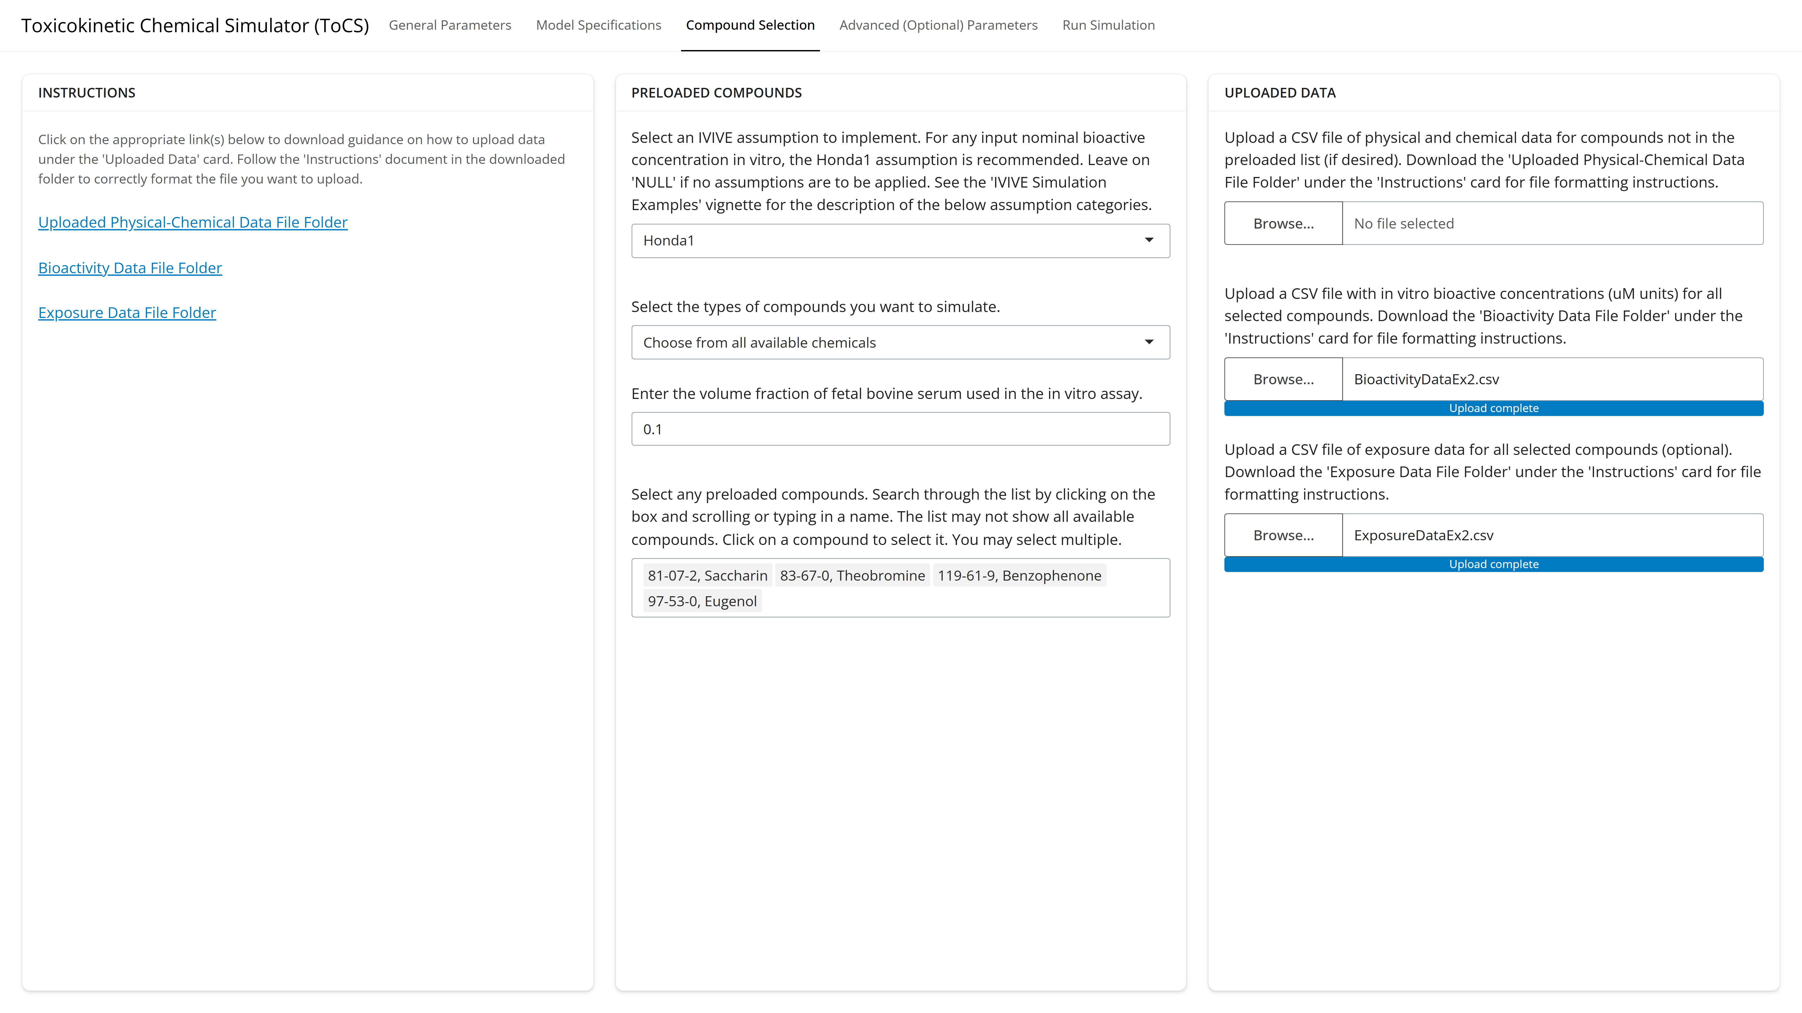
Example 2: Compound Selection Tab
Notes:
0,2,4,6,8,10,12,14,16,18,20,22,24,26,28,1,1,1,1,1,1,1,1,1,1,1,1,1,1,1

Slide 38
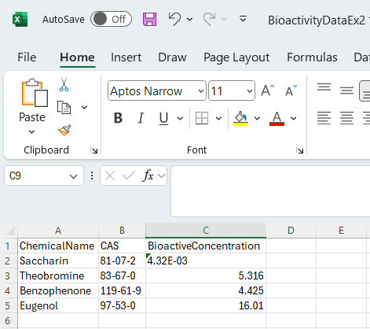
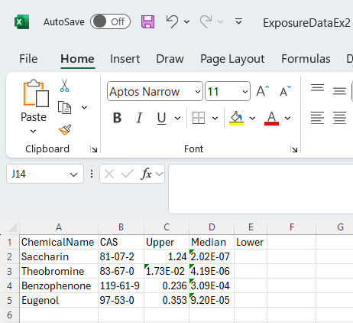
Example 2: Bioactivity and Exposure Data
Notes:
0,2,4,6,8,10,12,14,16,18,20,22,24,26,28,1,1,1,1,1,1,1,1,1,1,1,1,1,1,1

Slide 39

Example 2: Advanced Parameters Tab
Notes:
0,2,4,6,8,10,12,14,16,18,20,22,24,26,28,1,1,1,1,1,1,1,1,1,1,1,1,1,1,1

Slide 40
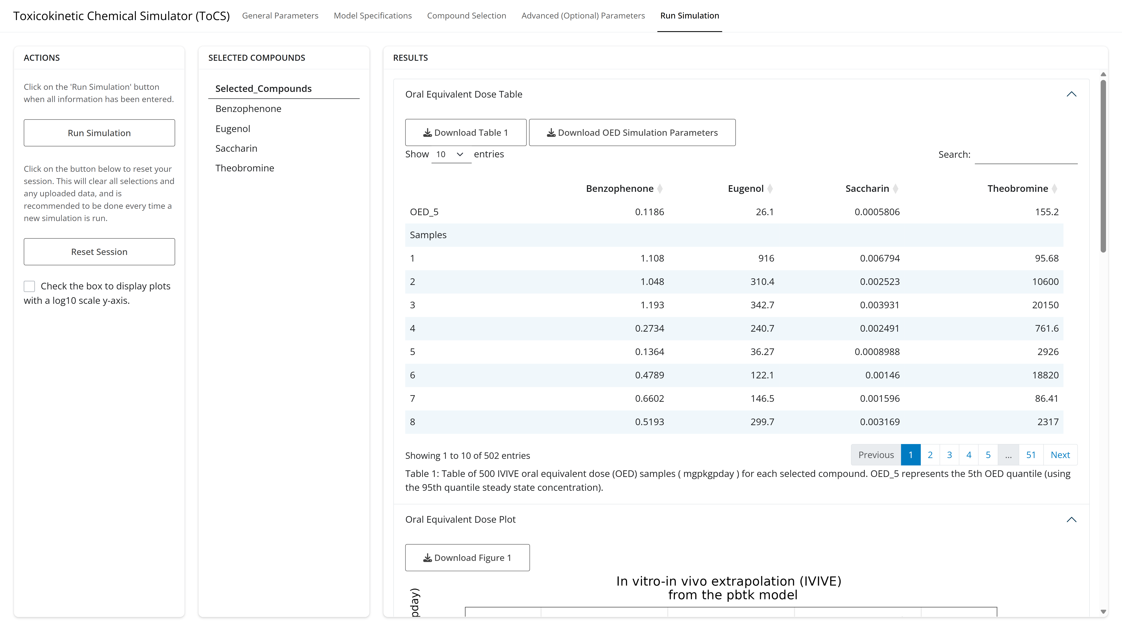
Example 2: Run Simulation Tab
Notes:
0,2,4,6,8,10,12,14,16,18,20,22,24,26,28,1,1,1,1,1,1,1,1,1,1,1,1,1,1,1

Slide 41
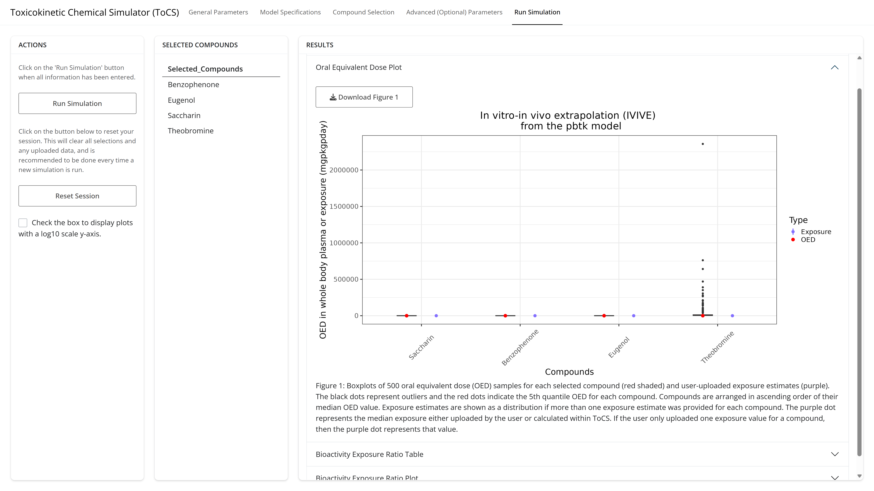
Example 2: Run Simulation Tab
Notes:
0,2,4,6,8,10,12,14,16,18,20,22,24,26,28,1,1,1,1,1,1,1,1,1,1,1,1,1,1,1

Slide 42
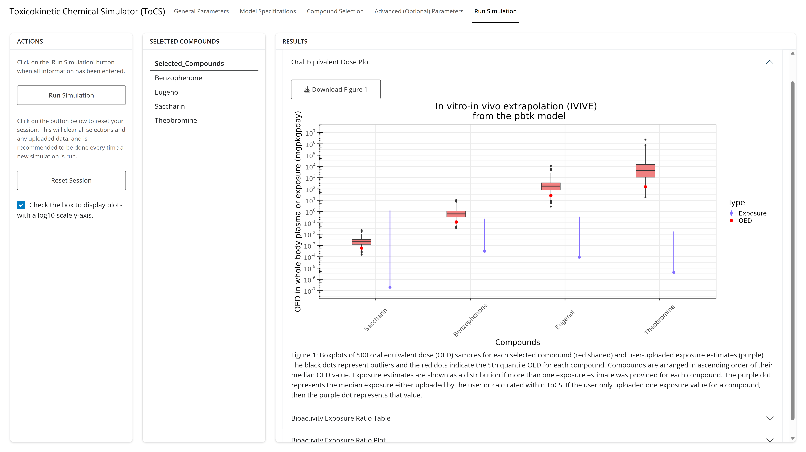
Example 2: Run Simulation Tab
Notes:
0,2,4,6,8,10,12,14,16,18,20,22,24,26,28,1,1,1,1,1,1,1,1,1,1,1,1,1,1,1

Slide 43
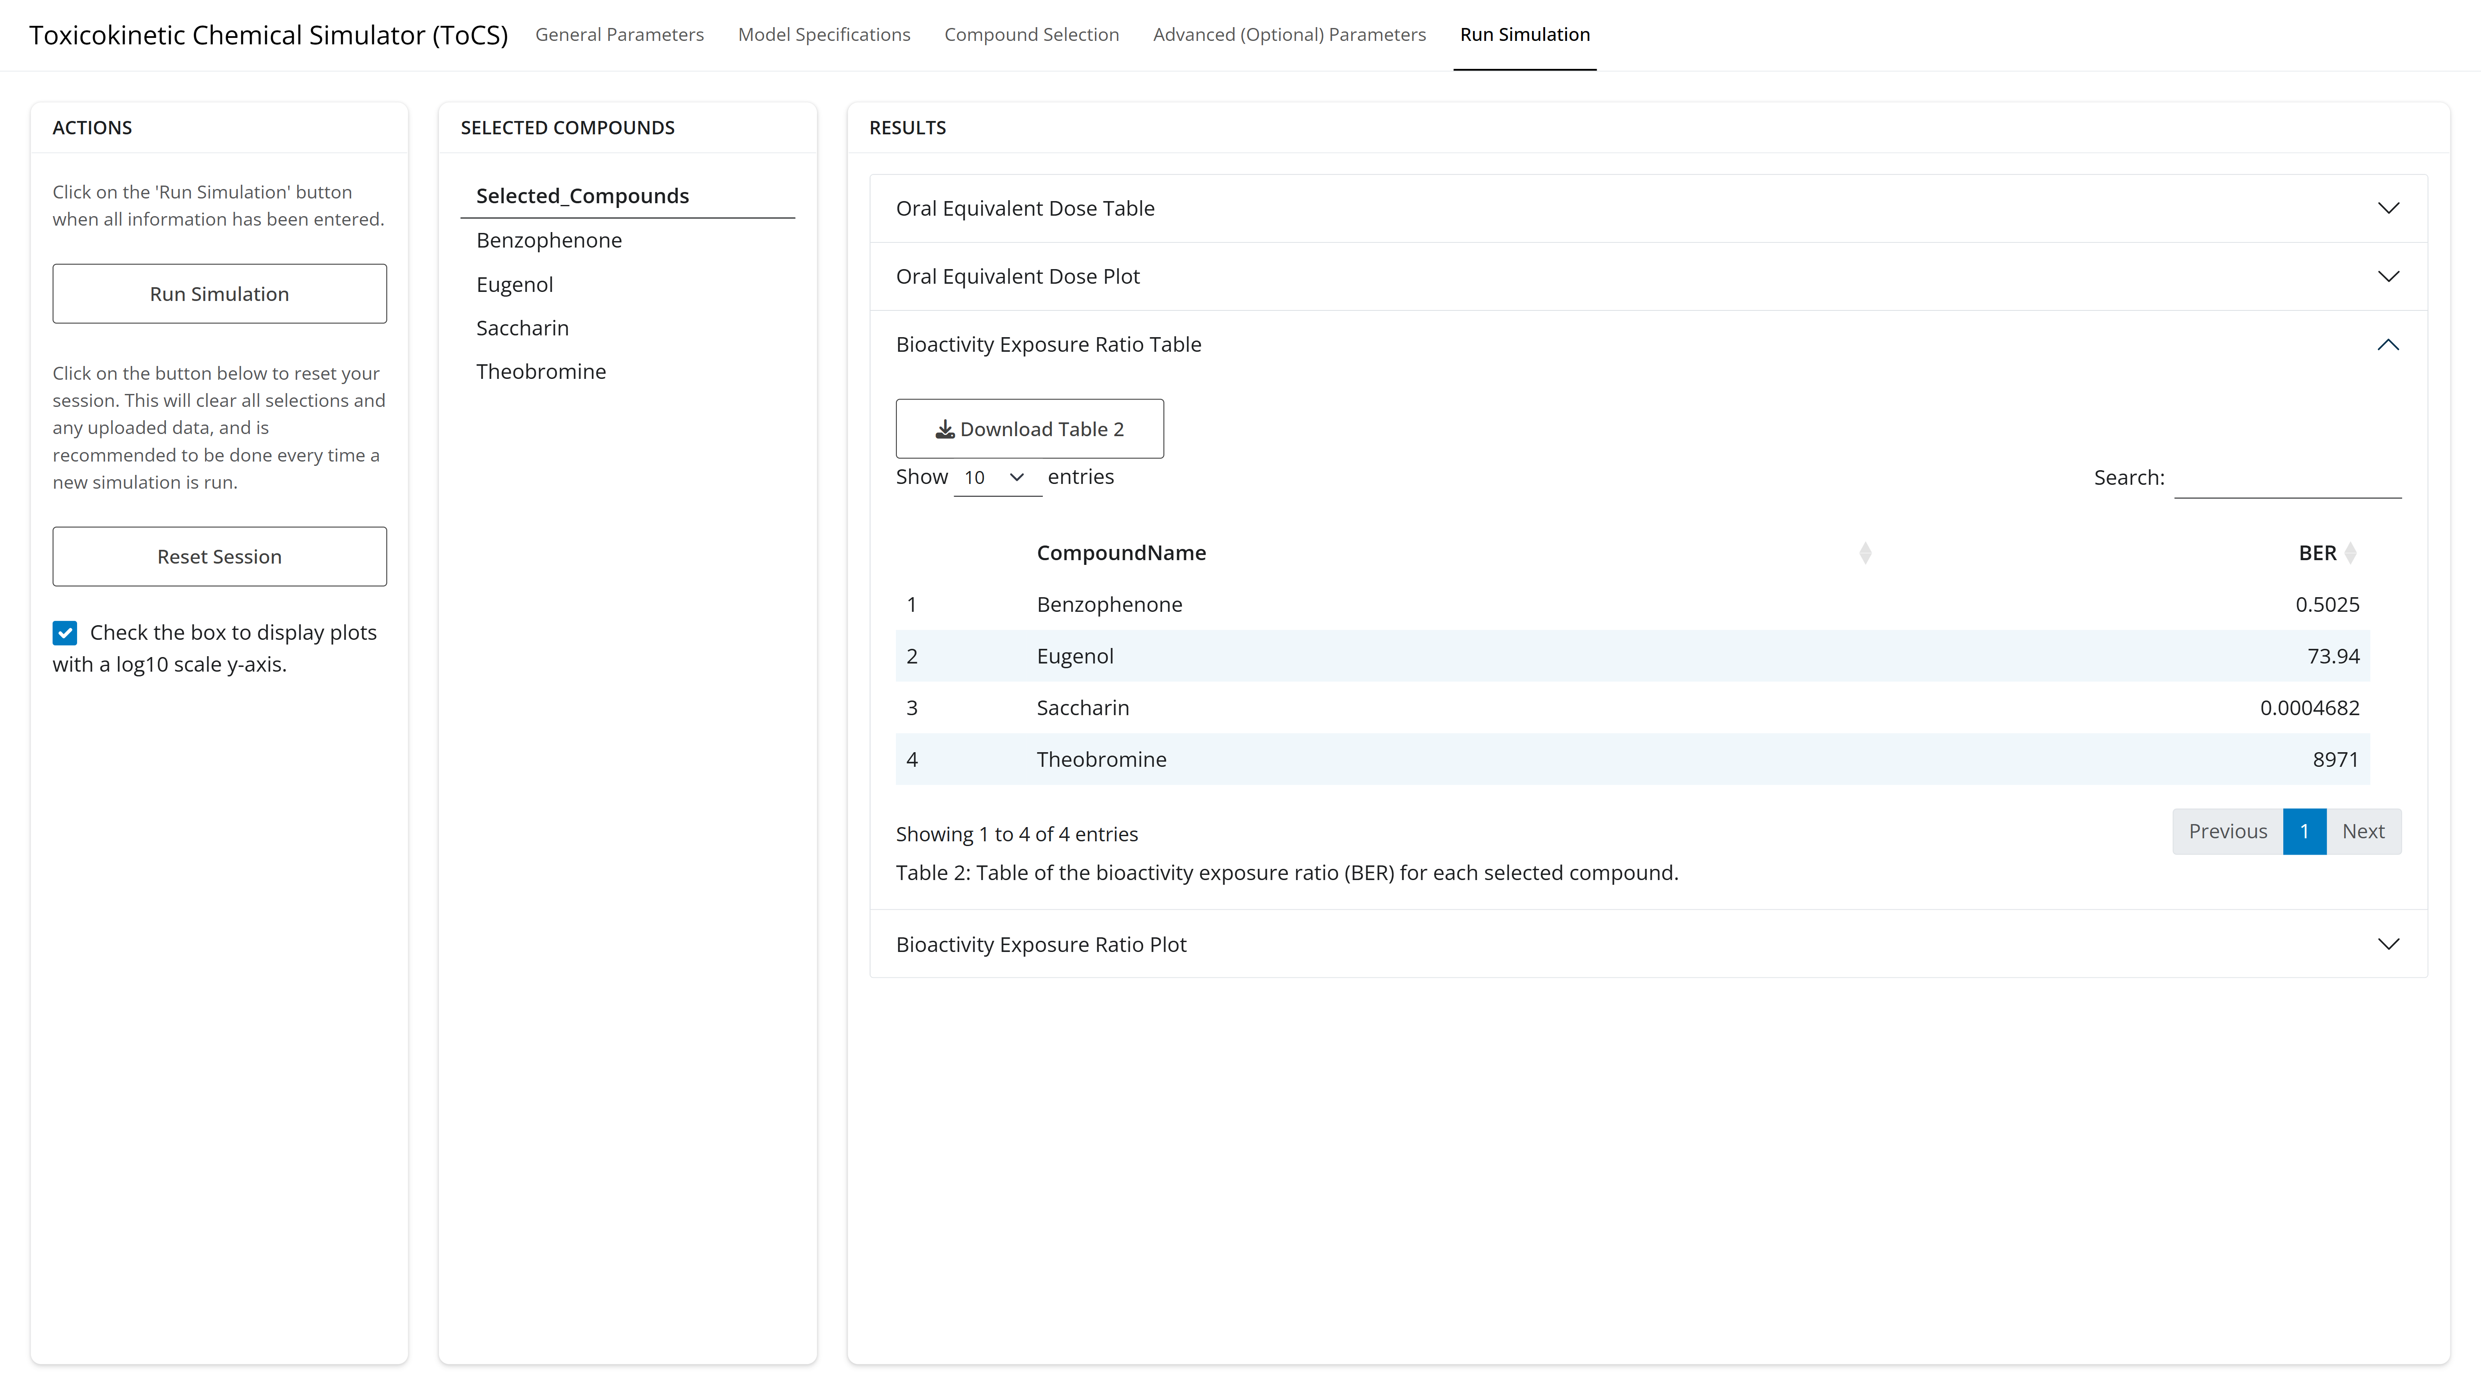
Example 2: Run Simulation Tab
Notes:
0,2,4,6,8,10,12,14,16,18,20,22,24,26,28,1,1,1,1,1,1,1,1,1,1,1,1,1,1,1

Slide 44
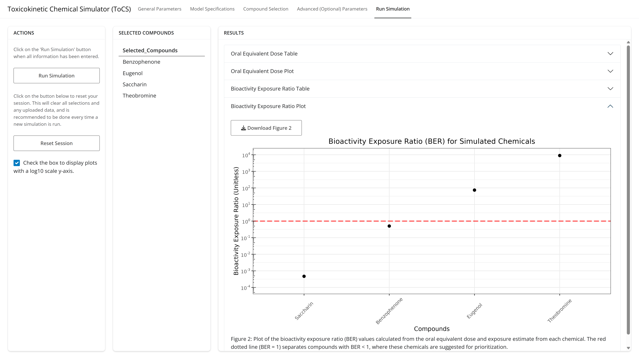
Example 2: Run Simulation Tab
Notes:
0,2,4,6,8,10,12,14,16,18,20,22,24,26,28,1,1,1,1,1,1,1,1,1,1,1,1,1,1,1

Slide 45
IVIVE Background
Try your own simulation in the IVIVE module
OR
Obtain the human bioactivity exposure ratios for the following chemicals
and use the following inputs:
Use the pbtk model and the Honda1 IVIVE condition
Use the 90th quantile steady state concentration (10th OED quantile)
Allow the use of in silico parameters
Chemical Name | CASRN | Bioactive Concentration (uM) | Exposure (mg/kg-BW/day)
FD&C Red 40 | 25956-17-6 | 11.58 | 6.77
Carminic acid | 1260-17-9 | 4.365 | 7.39E-3
FD&C Green 3 | 2353-45-9 | 5.998 | 1.40E-4
FD&C Yellow 6 | 2783-94-0 | 12.59 | 12.1

Slide 46
Questions?

